Slide 1
Towards Emotionally-Intelligent AI Systems
Opening
Part 1
understanding emotions from text
Part 2
emotion regulation with llms
Part 3
sustaining empathy with diverse discourse moves
Conclusion
takeaways
Hongli Zhan
Ph.D. Defense
The University of Texas at Austin
Dissertation Committee
Junyi Jessy Li, Supervisor
Kyle Mahowald · David I. Beaver · Desmond C. Ong
April 2, 2026
Notes:
Good afternoon, everyone. My name is Hong Li, and I'm here to present my dissertation work, Towards Emotionally Intelligent AI Systems. I'd like to thank my committee members: My advisor, Jessy, Kyle, David, and Desmond. Thank you all for your guidance during my PhD.

Slide 2
Opening
Part 1
understanding emotions from text
Part 2
emotion regulation with llms
Part 3
sustaining empathy with diverse discourse moves
Conclusion
takeaways
Deciphering Emotions from Text
EMNLP 2022
EMNLP 2023 Findings
Discourse Diversity in Multi-Turn Empathic Dialogue
Under review
1
3
Unveiling Advanced Psychological Capabilities from LLMs:
A Case of Targeted Reappraisal
COLM 2024
ICML 2025
2
4
Conclusion
Summary of Contributions
Notes:
My talk has three parts. First, I'll discuss how we can use language models to decipher emotions from text. Second, building on that understanding, I'll show how we can unlock advanced psychological capabilities from LLMs, specifically targeted reappraisal for emotion regulation. Both part 1 and part 2 focus on single-turn settings. In part three, I address the multi-turn challenge: how can LLMs sustain empathy across a full conversation? Finally, I'll conclude with a summary of contributions.

Slide 3
Opening
Part 1
understanding emotions from text
Part 2
emotion regulation with llms
Part 3
sustaining empathy with diverse discourse moves
Conclusion
takeaways
Deciphering Emotions from Text
EMNLP 2022
EMNLP 2023 Findings
Discourse Diversity in Multi-Turn Empathic Dialogue
Under review
1
3
Unveiling Advanced Psychological Capabilities from LLMs:
A Case of Targeted Reappraisal
COLM 2024
ICML 2025
2
4
Conclusion
Summary of Contributions

Slide 4
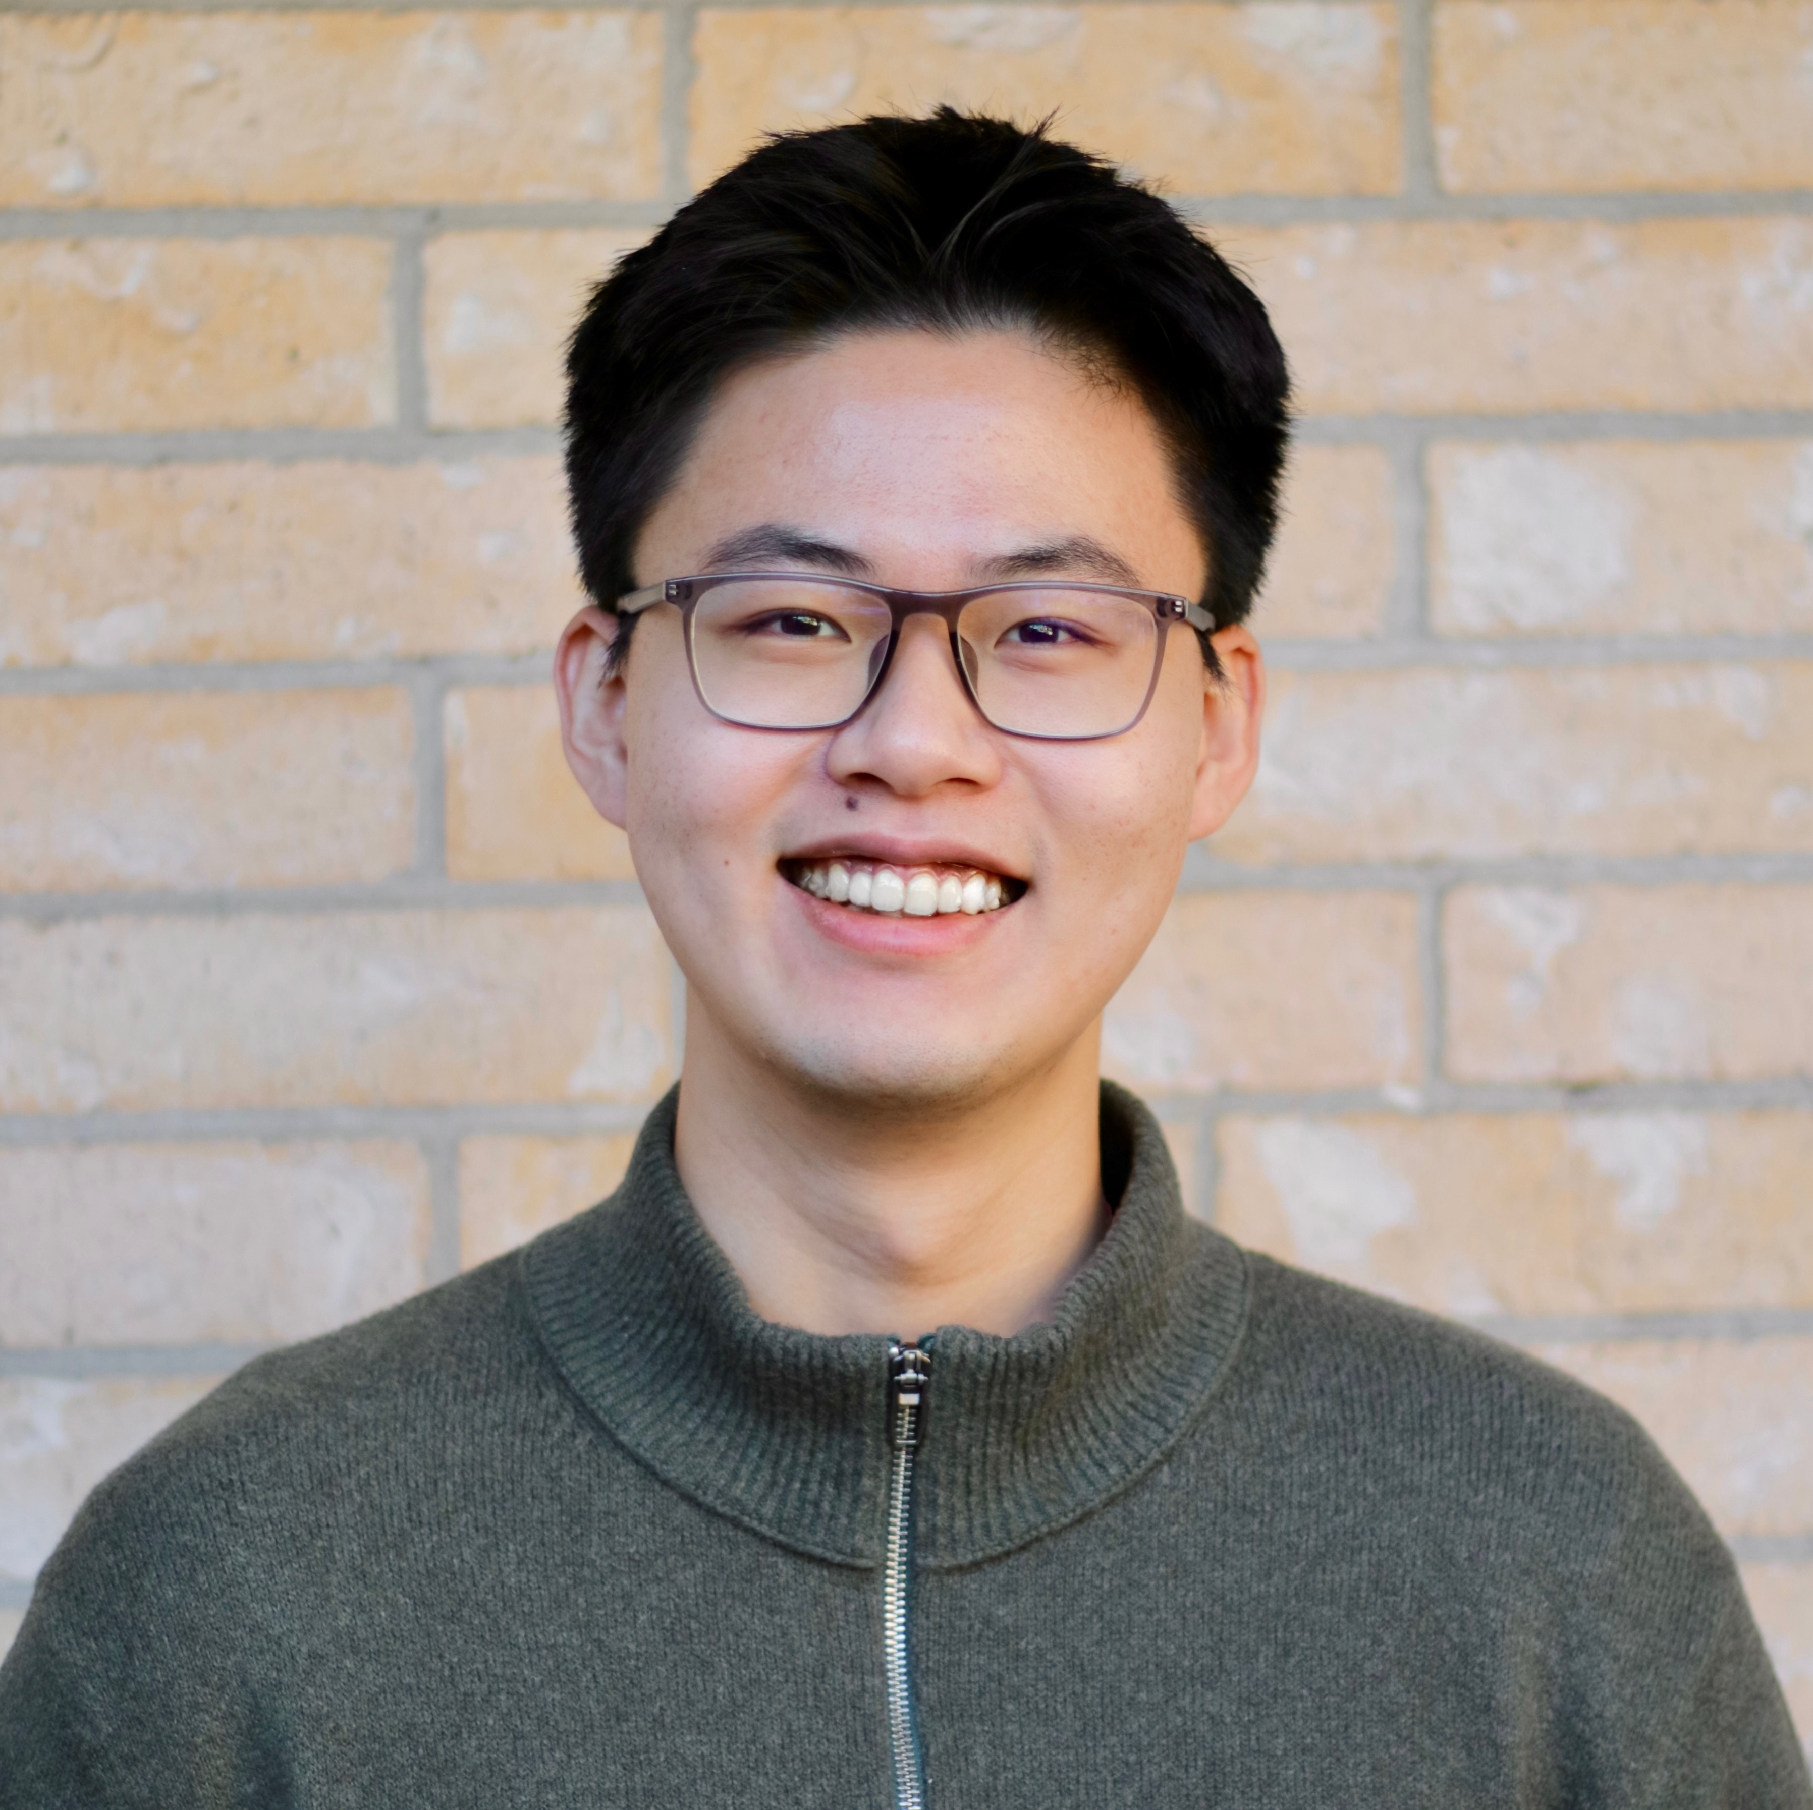


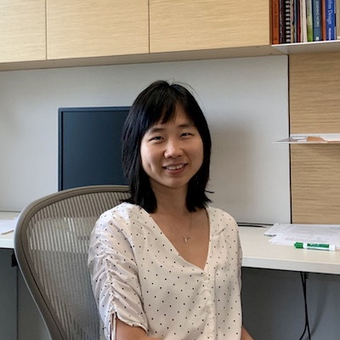
Part 1 (a)
Why Do You Feel This Way? Summarizing Triggers of Emotions in Social Media Posts
Opening
Part 1
understanding emotions from text
Part 2
emotion regulation with llms
Part 3
sustaining empathy with diverse discourse moves
Conclusion
takeaways
Hongli Zhan, Tiberiu Sosea, Cornelia Caragea, Junyi Jessy Li
In Proceedings of the 2022 Conference on Empirical Methods in Natural Language Processing (EMNLP 2022)
Notes:
The first work is a collaboration with Tiberiu, Cornelia, and my advisor Jessy, published at EMNLP 2022.

Slide 5
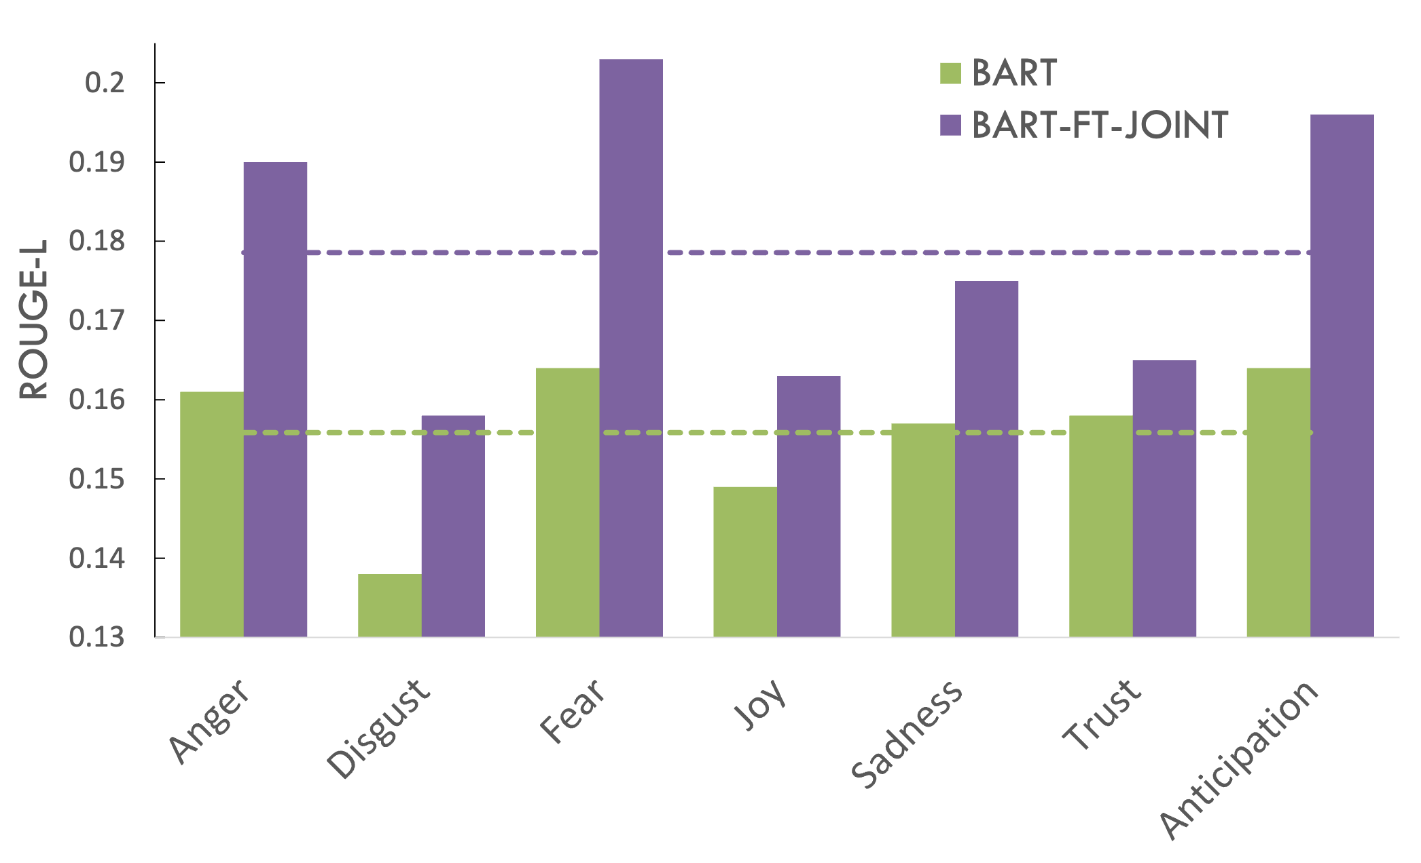
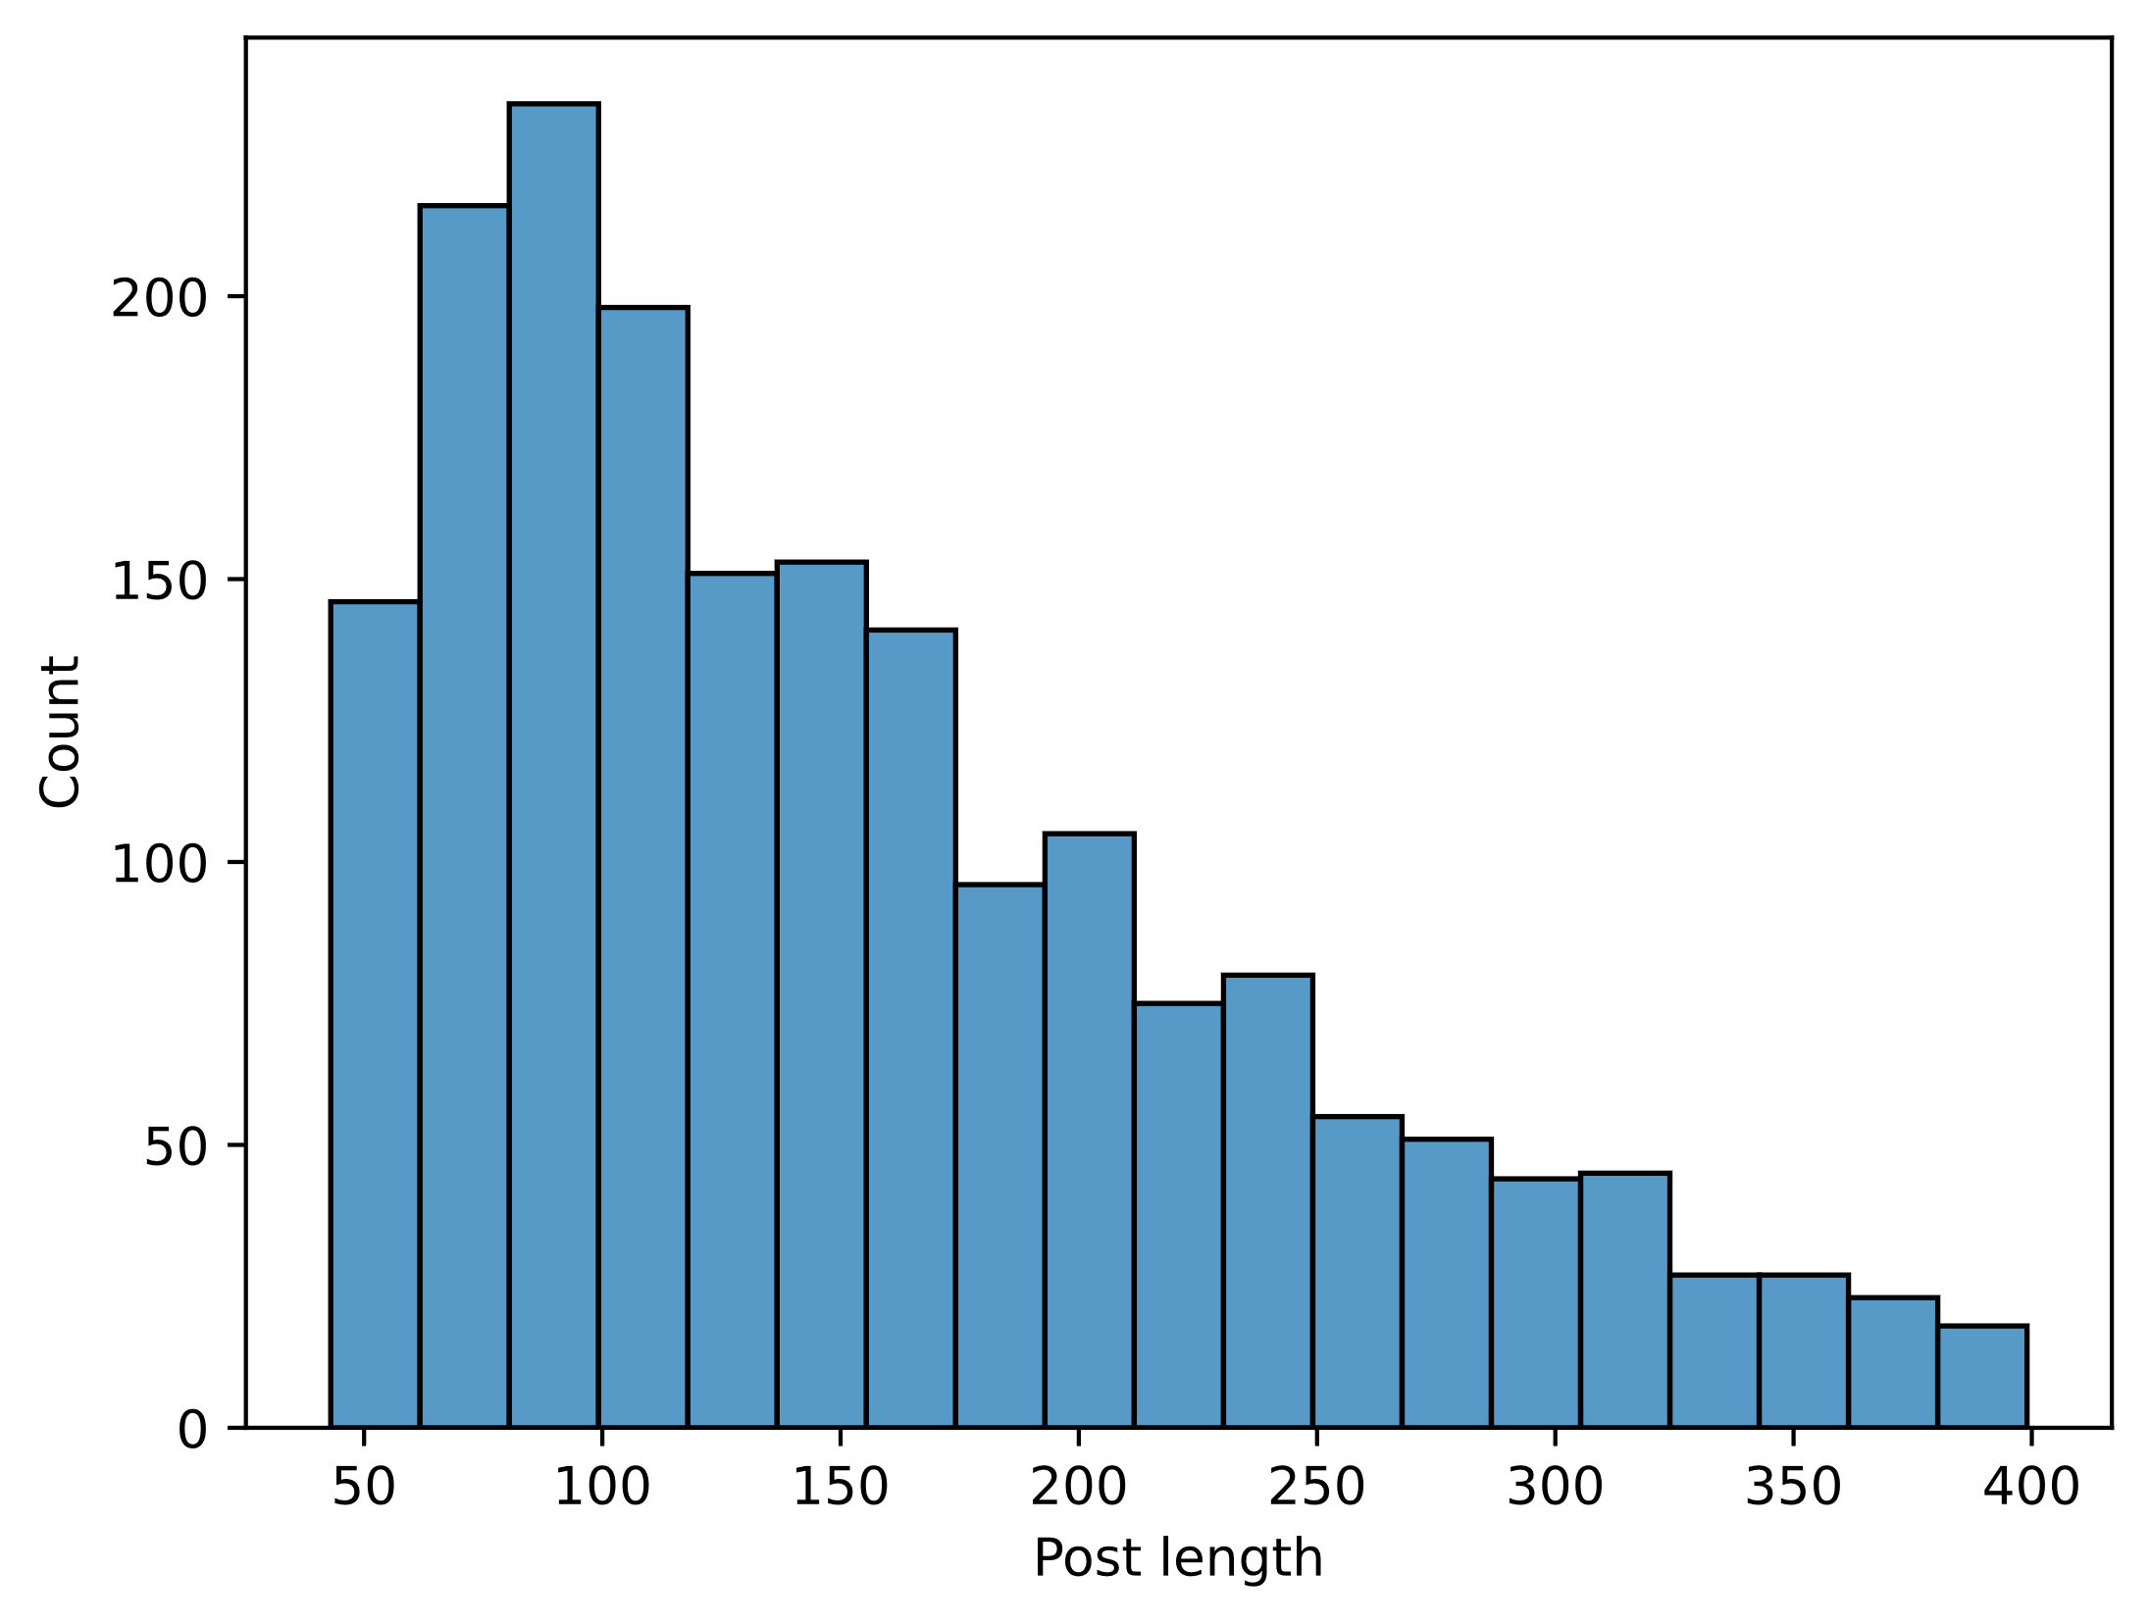
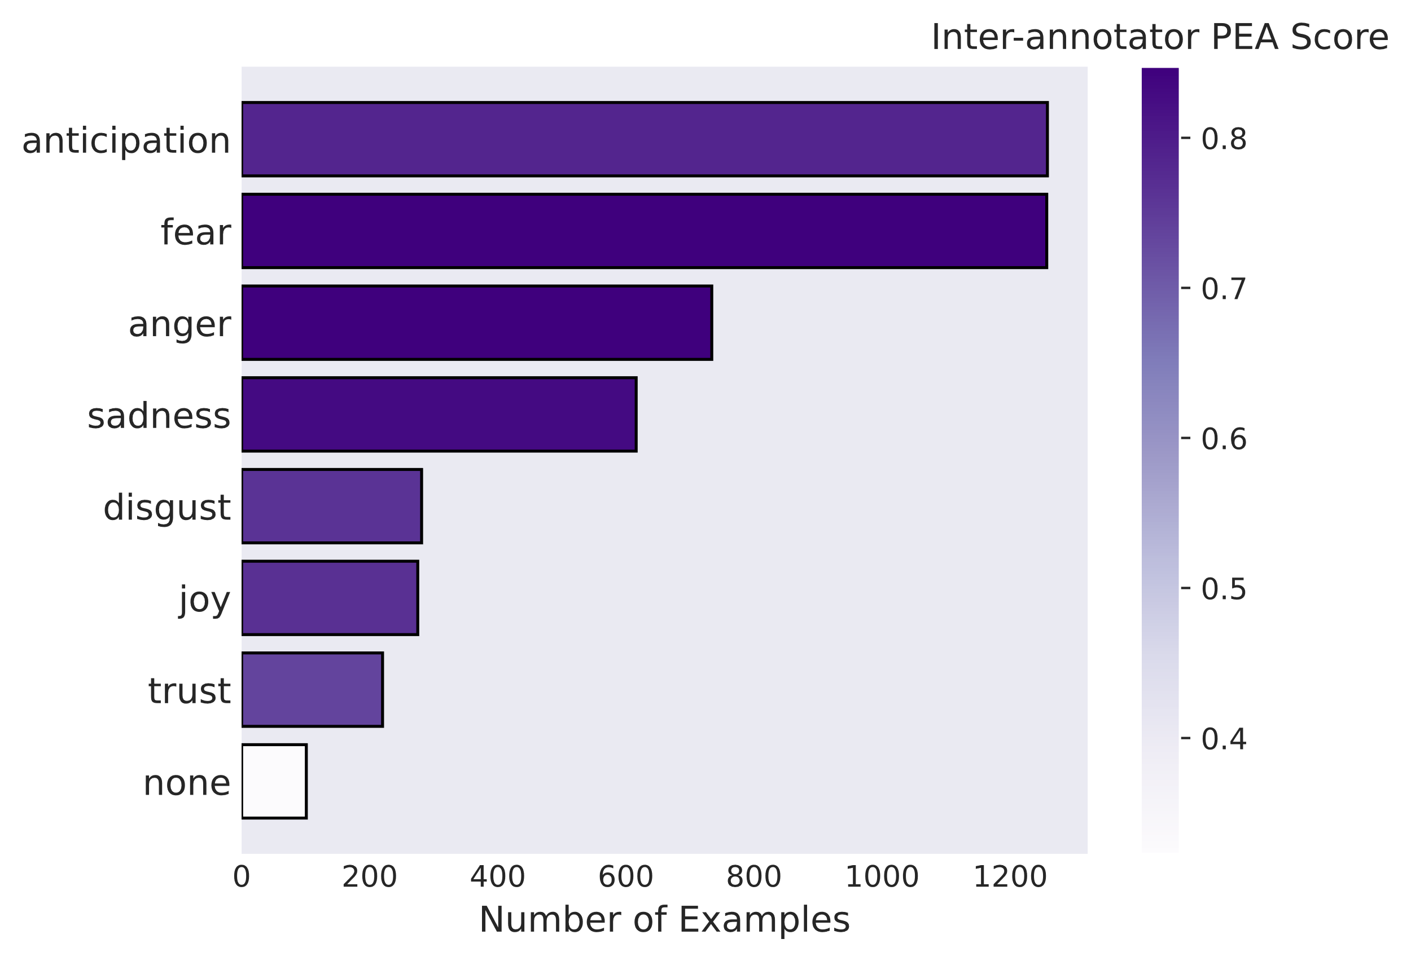
Summary of the Paper
Opening
Part 1
understanding emotions from text
Part 2
emotion regulation with llms
Part 3
sustaining empathy with diverse discourse moves
Conclusion
takeaways
Revealing “Why does the writer feel [emotion]?” is important yet remains unexplored:
We propose a new task: Emotion Detection & Trigger Summarization
New benchmark CovidET: Reddit posts annotated with emotions and their triggers
Benchmarking on the dataset, we were able to build automatic summarizers that outperform generic summarizers on the task of emotion-specific trigger summarization.
Zhan, Sosea, Caragea, Li (EMNLP 2022)
Notes:
In this work, we asked: why does a writer feel a certain emotion? Existing work could detect emotions, but not explain what triggered them. We proposed a new task, emotion trigger summarization...

Slide 6

Models can tell how people feel!
But is that enough?
Opening
Part 1
understanding emotions from text
Part 2
emotion regulation with llms
Part 3
sustaining empathy with diverse discourse moves
Conclusion
takeaways
How capable are language models of a deeper emotion understanding?
Notes:
So models can detect emotions and their triggers. But is that enough? How capable are they of a deeper emotional understanding?

Slide 7
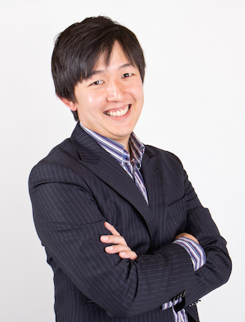
Part 1 (b)
Evaluating Subjective Cognitive Appraisals of Emotions from Large Language Models
Opening
Part 1
understanding emotions from text
Part 2
emotion regulation with llms
Part 3
sustaining empathy with diverse discourse moves
Conclusion
takeaways
Hongli Zhan, Desmond C. Ong, Junyi Jessy Li
In Findings of the Association for Computational Linguistics: EMNLP 2023
Notes:
We explored this question in our EMNLP 2023 Findings paper with Desmond and Jessy.

Slide 8
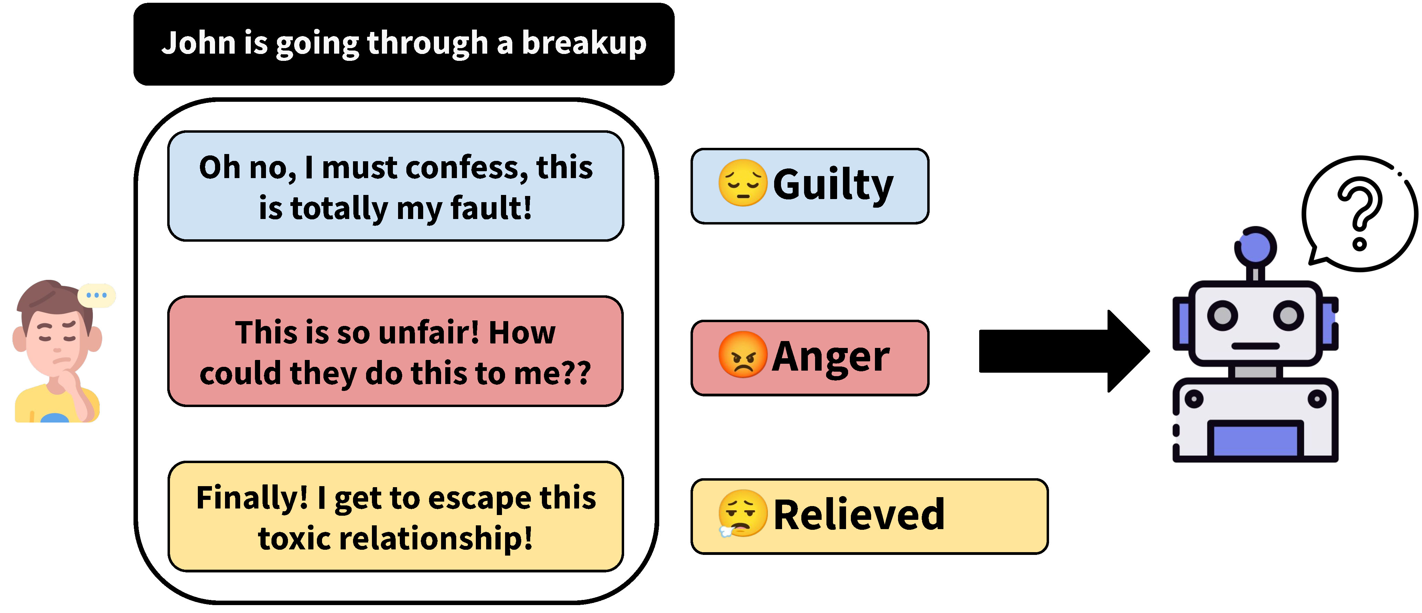
Cognitive Appraisals of Emotions
Opening
Part 1
understanding emotions from text
Part 2
emotion regulation with llms
Part 3
sustaining empathy with diverse discourse moves
Conclusion
takeaways
Cognitive appraisals: the same situation can often result in different emotional experiences, based on an individual's subjective evaluations.
This is typically characterized by a range of different “dimensions” (Arnold, 1960; Smith and Ellsworth, 1985; Yeo and Ong, 2023)
Zhan, Ong, Li (EMNLP 2023 Findings)
Notes:
And here we look at the psychological constructs: cognitive appraisals of emotions. To give you some background, this refers to …

Slide 9
Benchmark: CovidET-Appraisals
Opening
Part 1
understanding emotions from text
Part 2
emotion regulation with llms
Part 3
sustaining empathy with diverse discourse moves
Conclusion
takeaways
From a recent meta-analysis (Yeo & Ong, 2024), we identified a set of 24 appraisals, and created prompts, e.g., “To what extent did the narrator think that THEY were responsible for causing the situation?”
⇨ We then evaluated the accuracy of various LLMs in identifying these appraisals
Zhan, Ong, Li (EMNLP 2023 Findings)
Notes:
To evaluate LLMs on this task, we built a benchmark from a recent meta-analysis covering 24 appraisal dimensions. We measured the Spearman correlation between model predictions and human ratings…

Slide 10
LLMs are able to identify appraisals of emotions (without additional training)
Opening
Part 1
understanding emotions from text
Part 2
emotion regulation with llms
Part 3
sustaining empathy with diverse discourse moves
Conclusion
takeaways
⇨ Can we leverage this emotion understanding capability of LLMs to do good to humans?

Slide 11
Opening
Part 1
understanding emotions from text
Part 2
emotion regulation with llms
Part 3
sustaining empathy with diverse discourse moves
Conclusion
takeaways
Deciphering Emotions from Text
EMNLP 2022
EMNLP 2023 Findings
Discourse Diversity in Multi-Turn Empathic Dialogue
Under review
1
3
Unveiling Advanced Psychological Capabilities from LLMs:
A Case of Targeted Reappraisal
COLM 2024
ICML 2025
2
4
Conclusion
Summary of Contributions
Notes:
This brings us to part two…

Slide 12
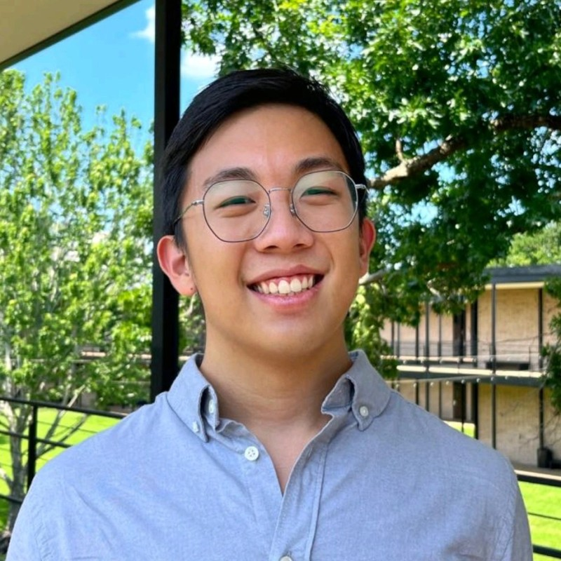
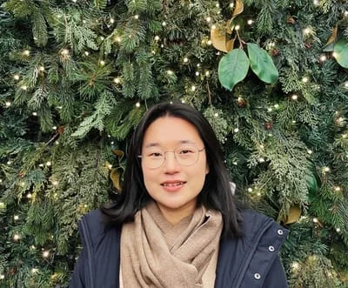

Part 2 (a)
Large Language Models are Capable of Offering Cognitive Reappraisal, if Guided
Opening
Part 1
understanding emotions from text
Part 2
emotion regulation with llms
Part 3
sustaining empathy with diverse discourse moves
Conclusion
takeaways
Hongli Zhan, Allen Zheng, Yoon Kyung Lee, Jina Suh, Junyi Jessy Li, Desmond Ong
In Proceedings of the First Conference on Language Modeling (COLM 2024)

Slide 13
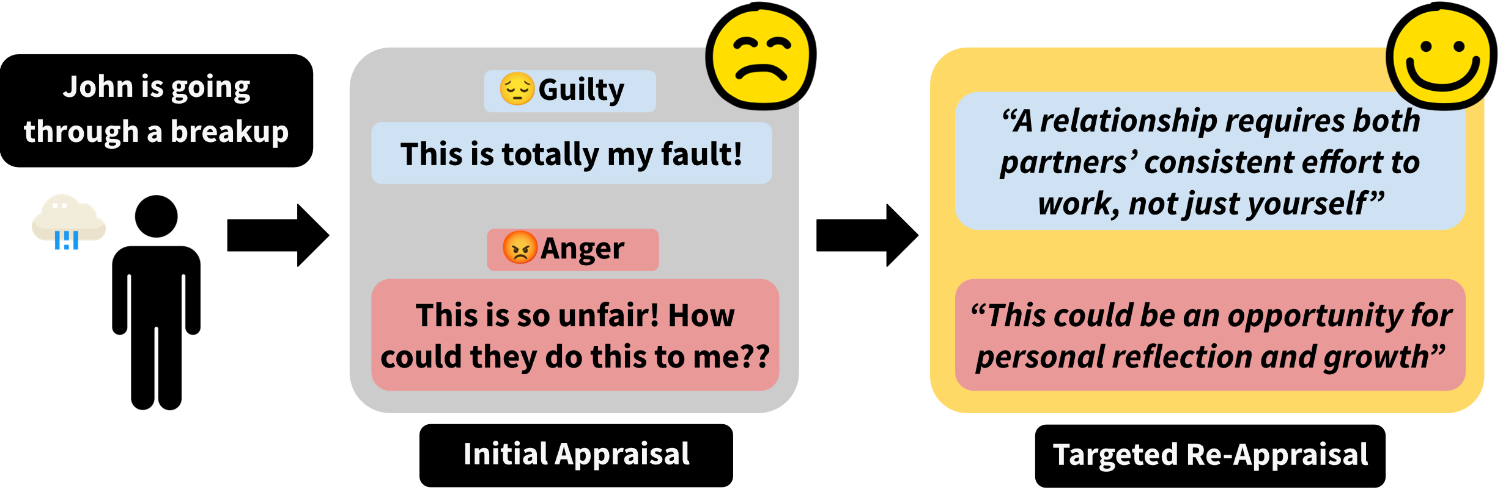

Targeted Reappraisal: A Toy Example
Opening
Part 1
understanding emotions from text
Part 2
emotion regulation with llms
Part 3
sustaining empathy with diverse discourse moves
Conclusion
takeaways
Can we use LLMs to achieve better emotional well-being through offering reappraisals?
⇨ Such an approach would be more targeted and precise
Zhan, Zheng, Lee, Suh, Li, Ong (COLM 2024)
Notes:
… The idea is simple: if we know which appraisal drives someone's emotion, we can target that specific dimension to regulate their emotion …

Slide 14

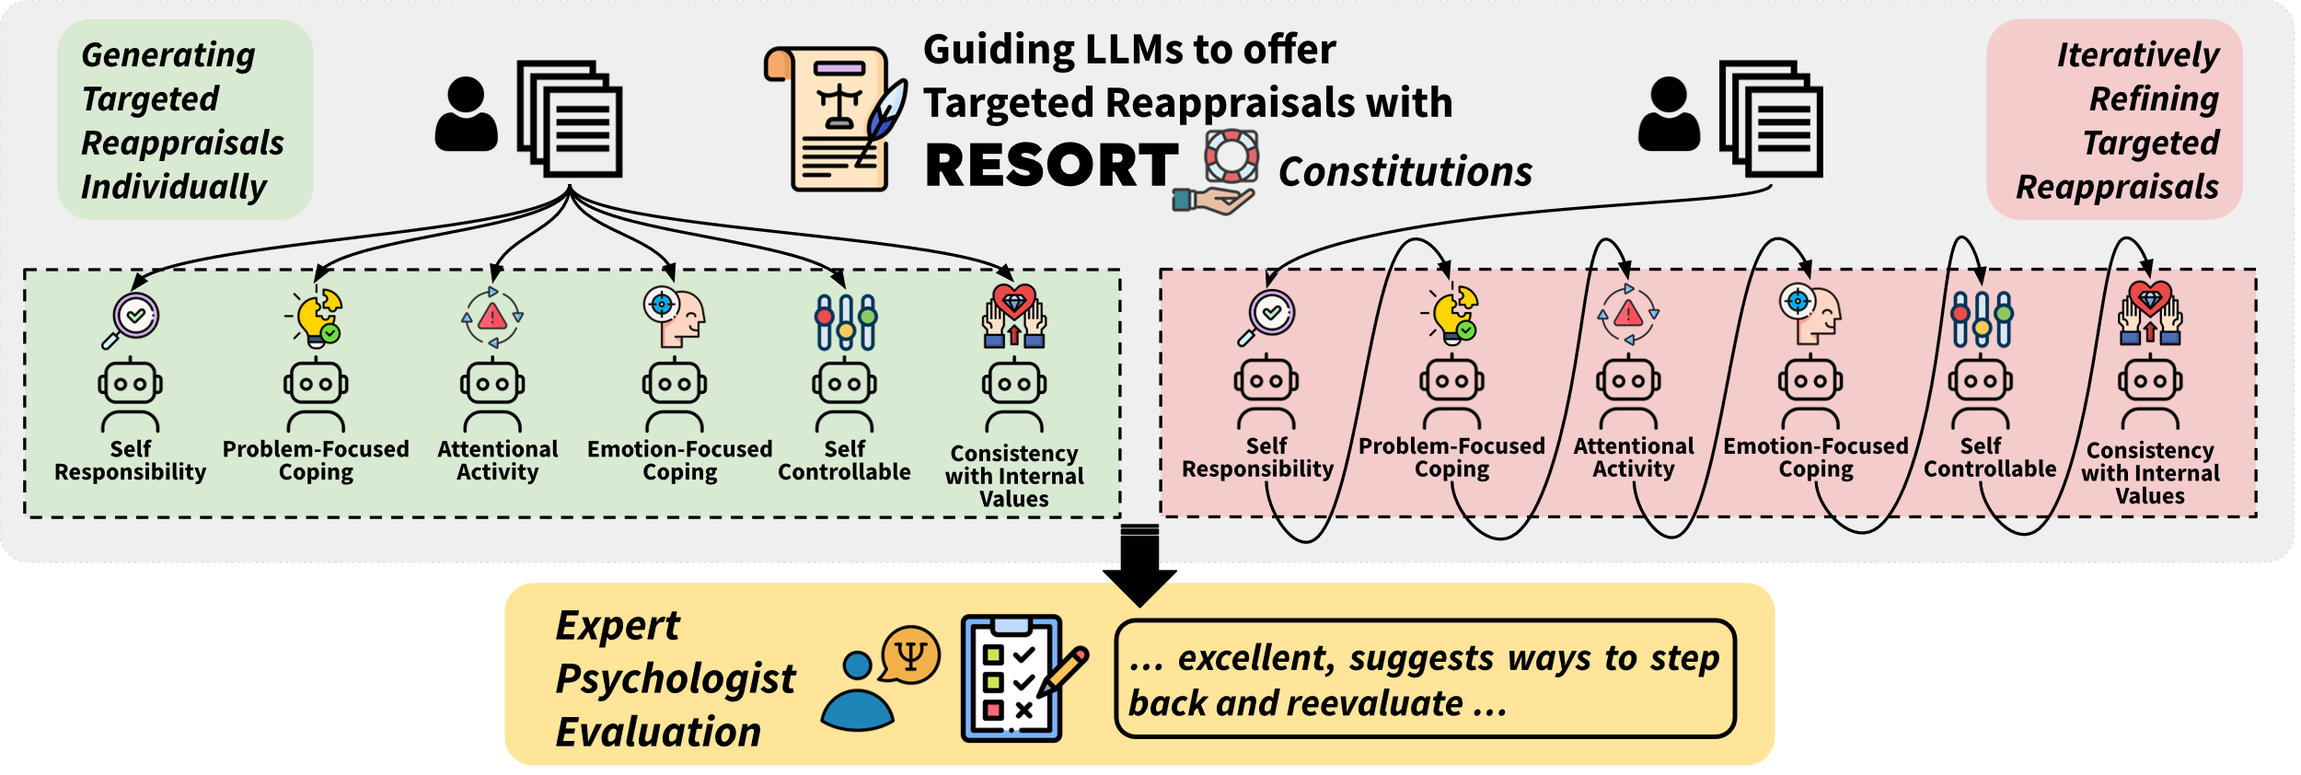
New Framework: RESORT
Opening
Part 1
understanding emotions from text
Part 2
emotion regulation with llms
Part 3
sustaining empathy with diverse discourse moves
Conclusion
takeaways
We designed a system, entitled RESORT, to guide LLMs to offer targeted reappraisals along six appraisal dimensions chosen to maximize coverage
Zhan, Zheng, Lee, Suh, Li, Ong (COLM 2024)

Slide 15
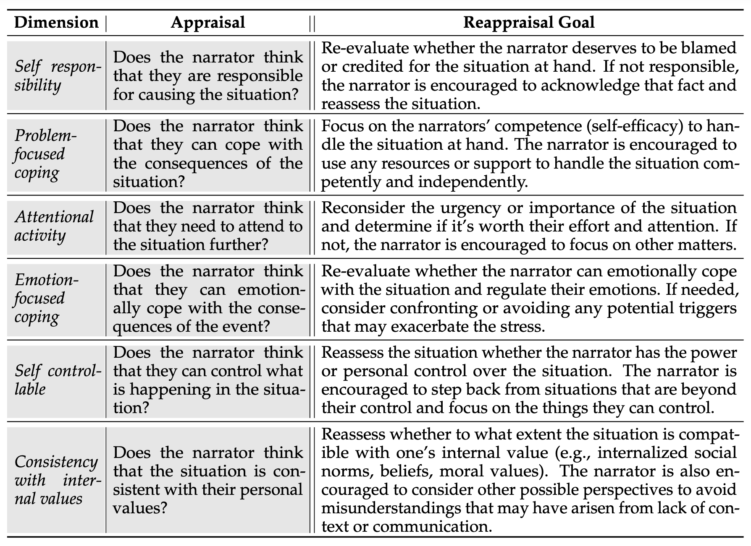
Expert-Crafted Guiding Constitutions
Opening
Part 1
understanding emotions from text
Part 2
emotion regulation with llms
Part 3
sustaining empathy with diverse discourse moves
Conclusion
takeaways
Constitutional Principles
Zhan, Zheng, Lee, Suh, Li, Ong (COLM 2024)

Slide 16
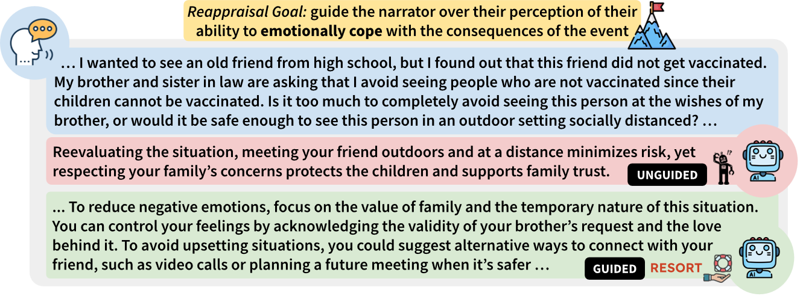
Example Generation
Opening
Part 1
understanding emotions from text
Part 2
emotion regulation with llms
Part 3
sustaining empathy with diverse discourse moves
Conclusion
takeaways
Guided by RESORT , GPT4 turbo is able to zoom in on the appraisal dimension
“emotionally-focused coping” to help the narrator reappraise their situation
Zhan, Zheng, Lee, Suh, Li, Ong (COLM 2024)
Notes:
Let me show you a concrete example. Here the user is struggling with visiting an unvaccinated friend and doesn't know how to cope emotionally. A vanilla model gives a generic, surface-level response. But guided by RESORT, the same model zooms into the emotional coping dimension and produces a much more targeted reappraisal, helping the user reframe how they feel about the situation. This is the kind of precision our framework enables.

Slide 17
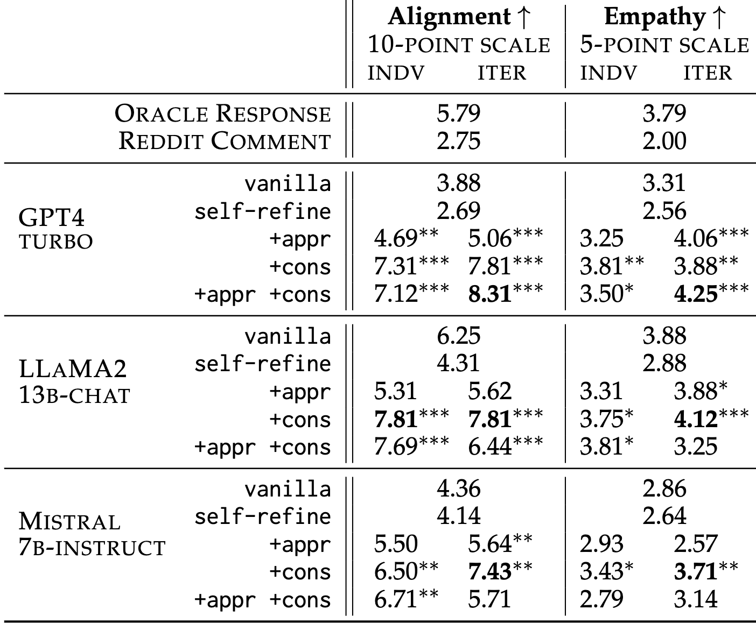
Psychology Experts’ Evaluation
Opening
Part 1
understanding emotions from text
Part 2
emotion regulation with llms
Part 3
sustaining empathy with diverse discourse moves
Conclusion
takeaways
For evaluation, we recruited 4 psychologists with expertise in clinical psychology
All evaluators hold M.S./Ph.D. degrees
Evaluation done by psychologists suggest that responses from our system are:
(i) aligned (with reappraisal definitions)
(ii) empathic compared to various baselines
Zhan, Zheng, Lee, Suh, Li, Ong (COLM 2024)

Slide 18
LLMs (under expert guidance) can generate targeted reappraisals that are both “aligned” and empathic
Opening
Part 1
understanding emotions from text
Part 2
emotion regulation with llms
Part 3
sustaining empathy with diverse discourse moves
Conclusion
takeaways
⇨ Is it possible to automate the guiding process with as little human supervision as possible?
Notes:
However, one caveat with guiding language models using human expertise is that the process can be both time-consuming and expensive, especially when it involves expert psychologists

Slide 19


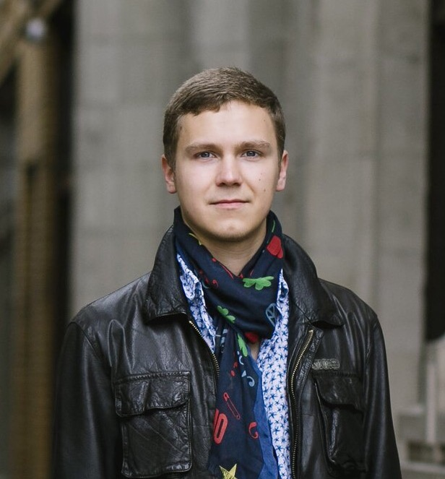
Part 2 (b)
SPRI: Aligning Large Language Models with Context-Situated Principles
Opening
Part 1
understanding emotions from text
Part 2
emotion regulation with llms
Part 3
sustaining empathy with diverse discourse moves
Conclusion
takeaways
Hongli Zhan, Muneeza Azmat, Raya Horesh, Junyi Jessy Li, Mikhail Yurochkin
In Proceedings of the 42nd International Conference on Machine Learning (ICML 2025)
Work done during internship at IBM Research

Slide 20
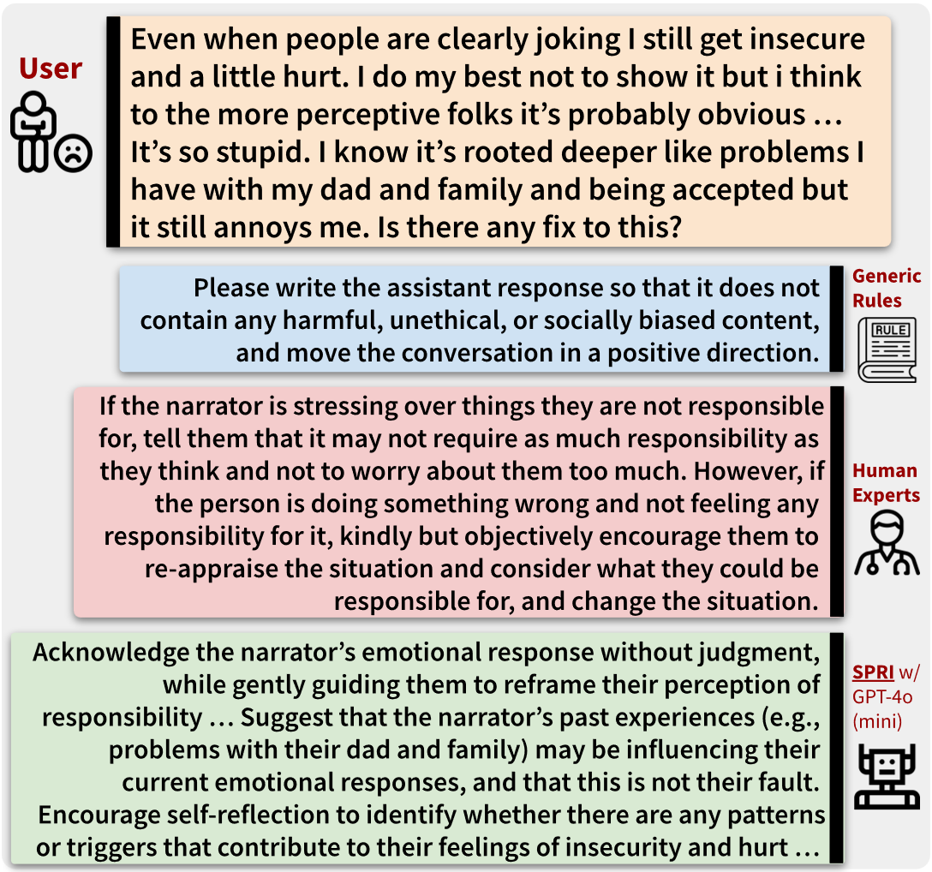

Motivation
Opening
Part 1
understanding emotions from text
Part 2
emotion regulation with llms
Part 3
sustaining empathy with diverse discourse moves
Conclusion
takeaways
In the context of providing cognitive reappraisals for emotional support to users in distress:
Generic principles are often insufficient to capture the complexities of the use-case
Expert-written guidance takes too much time
Can we build a framework that tailors the guidance to each individual query, whilst minimizing the human efforts needed for annotations?
Zhan, Azmat, Horesh, Li, Yurochkin (ICML 2025)

Slide 21





Introducing: Situated-PRInciples (SPRI)
Opening
Part 1
understanding emotions from text
Part 2
emotion regulation with llms
Part 3
sustaining empathy with diverse discourse moves
Conclusion
takeaways
Stage 1: Generate a set of principles to guide the response to the user’s input
Stage 2: Generate a response to the user’s input by adhering to the principles
Seed (Instruction, Principle) Examples
Base LLM
Base LLM
Generate initial principles
Final
Principles
Generate an initial response that adheres to the principles from Stage 1
Final Response
User Input
… it’s essential to work closely with your doctor to develop a personalized plan. Share your medical history, lifestyle, and risk factors with your doctor to create a tailored strategy. Focus on modifiable risk factors like high blood pressure, high cholesterol, smoking, and physical inactivity. Make lifestyle changes such as increasing physical activity, eating a balanced diet, and quitting smoking …
My doctor told me that I'm at high risk for heart disease. What should I do?
… prioritize personalized guidance over generic advice, considering the individual’s unique medical history, lifestyle, and risk factors. Emphasize the importance of consulting with a healthcare professional to develop a tailored plan. Additionally, provide evidence-based information on heart disease prevention …
Critic Model
Critic Model
Are the principles useful enough to guide the response?
YES
Does the response align well with the principles?
YES
NO
NO
Base LLM
Base LLM
Refine the principles based on feedback
Refine the response based on feedback
Zhan, Azmat, Horesh, Li, Yurochkin (ICML 2025)
Notes:
Seed example: this is where the minimal human supervision comes in. We evaluate the ability of LLMs using only 1 oracle example as the seed example.

Slide 22
Evaluation Setup
Opening
Part 1
understanding emotions from text
Part 2
emotion regulation with llms
Part 3
sustaining empathy with diverse discourse moves
Conclusion
takeaways
we provide SPRI with a single oracle (expert-written) reappraisal constitution as the seed example in the initial principle-generation stage.
Evaluation Data: 30 Reddit posts from (Zhan et al., COLM 2024)
We carry out automatic evaluation on all reappraisal responses elicited using GPT-4-0613
Which showed strong correlation with evaluation results conducted by professional psychologists in Zhan et al. (COLM 2024)
Zhan, Azmat, Horesh, Li, Yurochkin (ICML 2025)

Slide 23
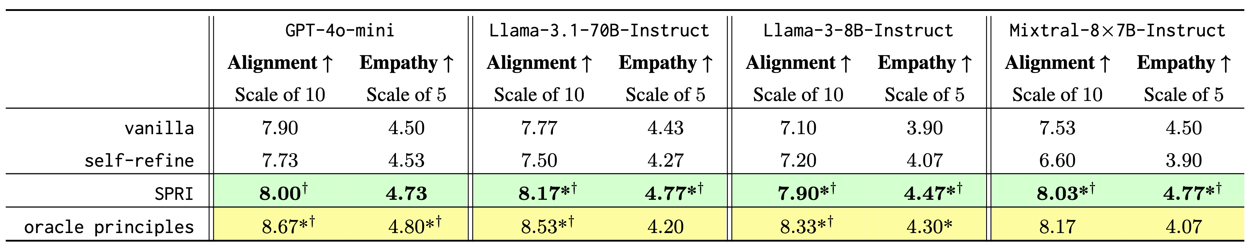
Evaluation Results for Cognitive Reappraisal
Opening
Part 1
understanding emotions from text
Part 2
emotion regulation with llms
Part 3
sustaining empathy with diverse discourse moves
Conclusion
takeaways
SPRI consistently outperforms methods that lack access to oracle principles both in terms of reappraisal alignment and perceived empathy, even though it only utilizes a single seed principle.
Zhan, Azmat, Horesh, Li, Yurochkin (ICML 2025)

Slide 24
LLMs Do Well on These Emotion Tasks!
But they were all carried out in single-turn settings
Opening
Part 1
understanding emotions from text
Part 2
emotion regulation with llms
Part 3
sustaining empathy with diverse discourse moves
Conclusion
takeaways
Empathy is not just about one good response.
It is about adapting your support as a conversation unfolds.
⇨ Can LLMs sustain this across multi-turn conversations?

Slide 25
Opening
Part 1
understanding emotions from text
Part 2
emotion regulation with llms
Part 3
sustaining empathy with diverse discourse moves
Conclusion
takeaways
Deciphering Emotions from Text
EMNLP 2022
EMNLP 2023 Findings
Discourse Diversity in Multi-Turn Empathic Dialogue
Under review
1
3
Unveiling Advanced Psychological Capabilities from LLMs:
A Case of Targeted Reappraisal
COLM 2024
ICML 2025
2
4
Conclusion
Summary of Contributions

Slide 26


Part 3
Discourse Diversity in
Multi-Turn Empathic Dialogue
Opening
Part 1
understanding emotions from text
Part 2
emotion regulation with llms
Part 3
sustaining empathy with diverse discourse moves
Conclusion
takeaways
Hongli Zhan, Emma Gueorguieva, Javier Hernandez, Jina Suh, Desmond C. Ong, Junyi Jessy Li
Under Review

Slide 27
LLM Responses Are Perceived as Empathic in single turns
Opening
Part 1
understanding emotions from text
Part 2
emotion regulation with llms
Part 3
sustaining empathy with diverse discourse moves
Conclusion
takeaways
LLMs score high on empathy, but what is actually in the language of these responses?
In single-turn evaluations,
raters judge LLM responses as more empathic
Results from: Lee, Suh, Zhan, Li, Ong (ACII 2024)

Slide 28
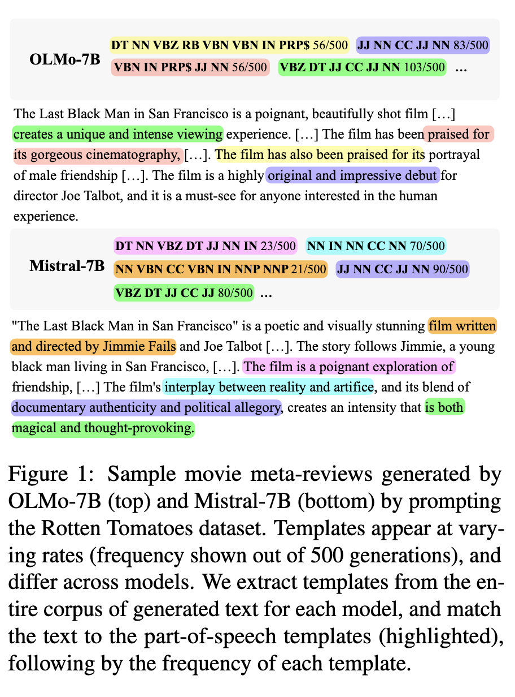
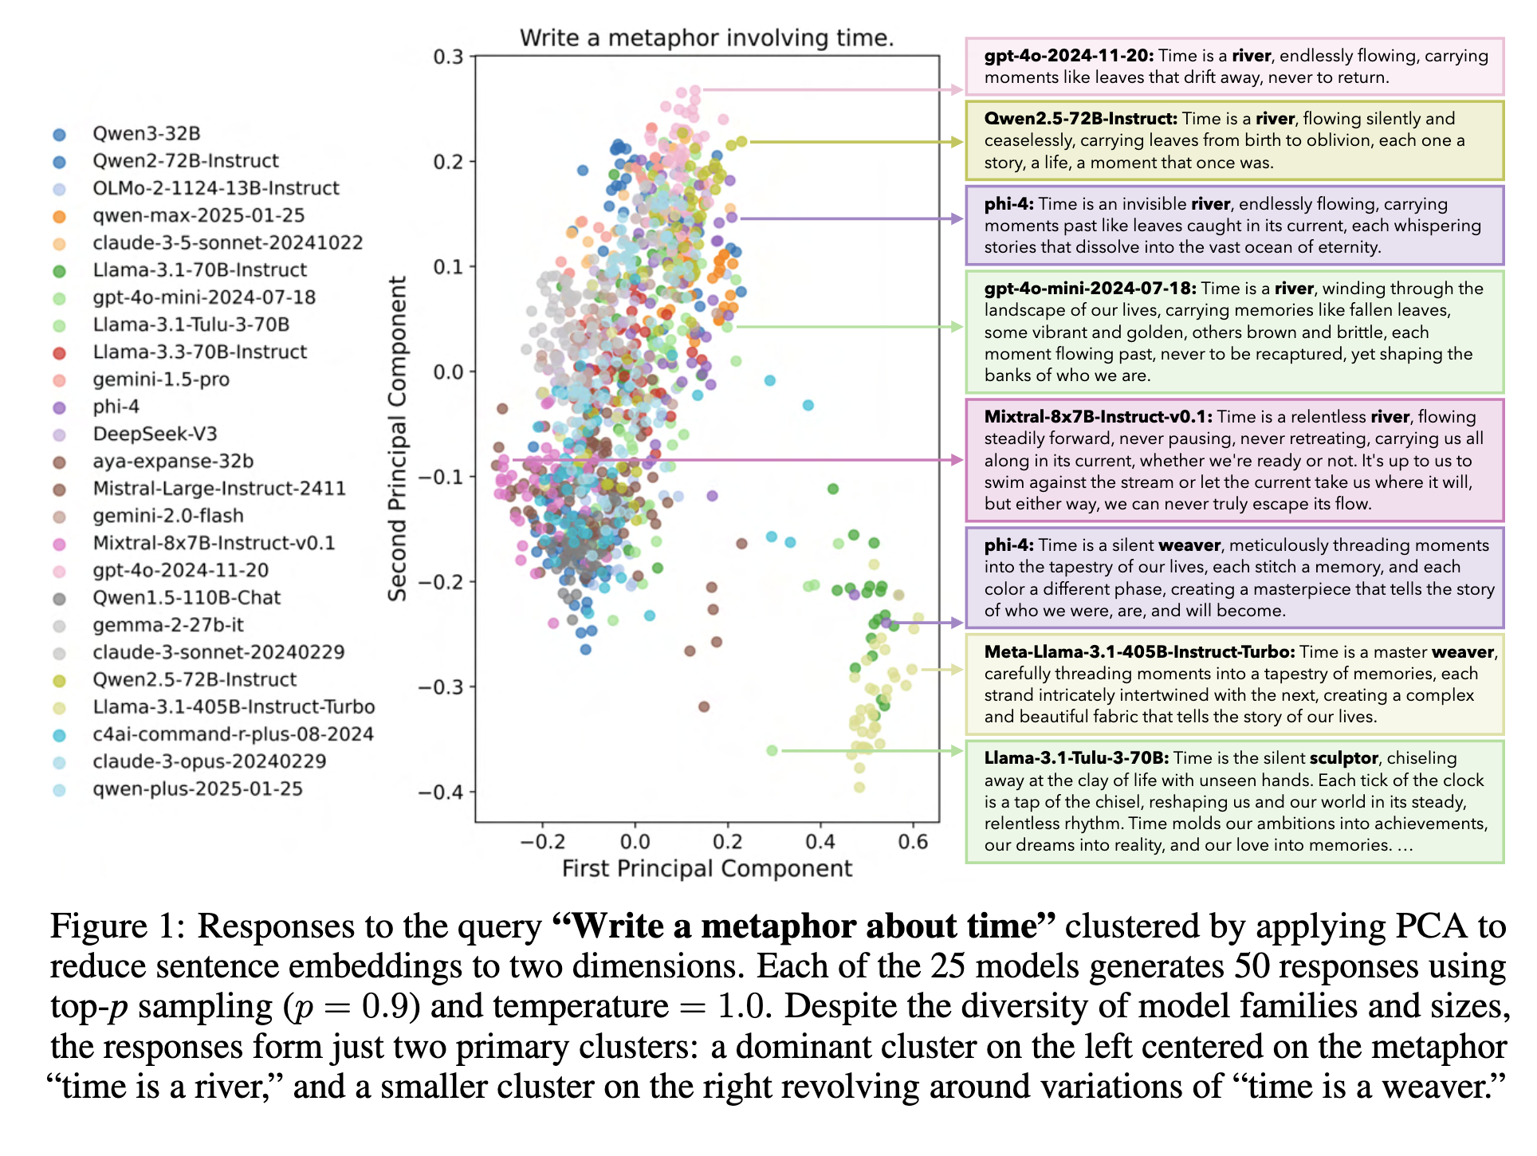
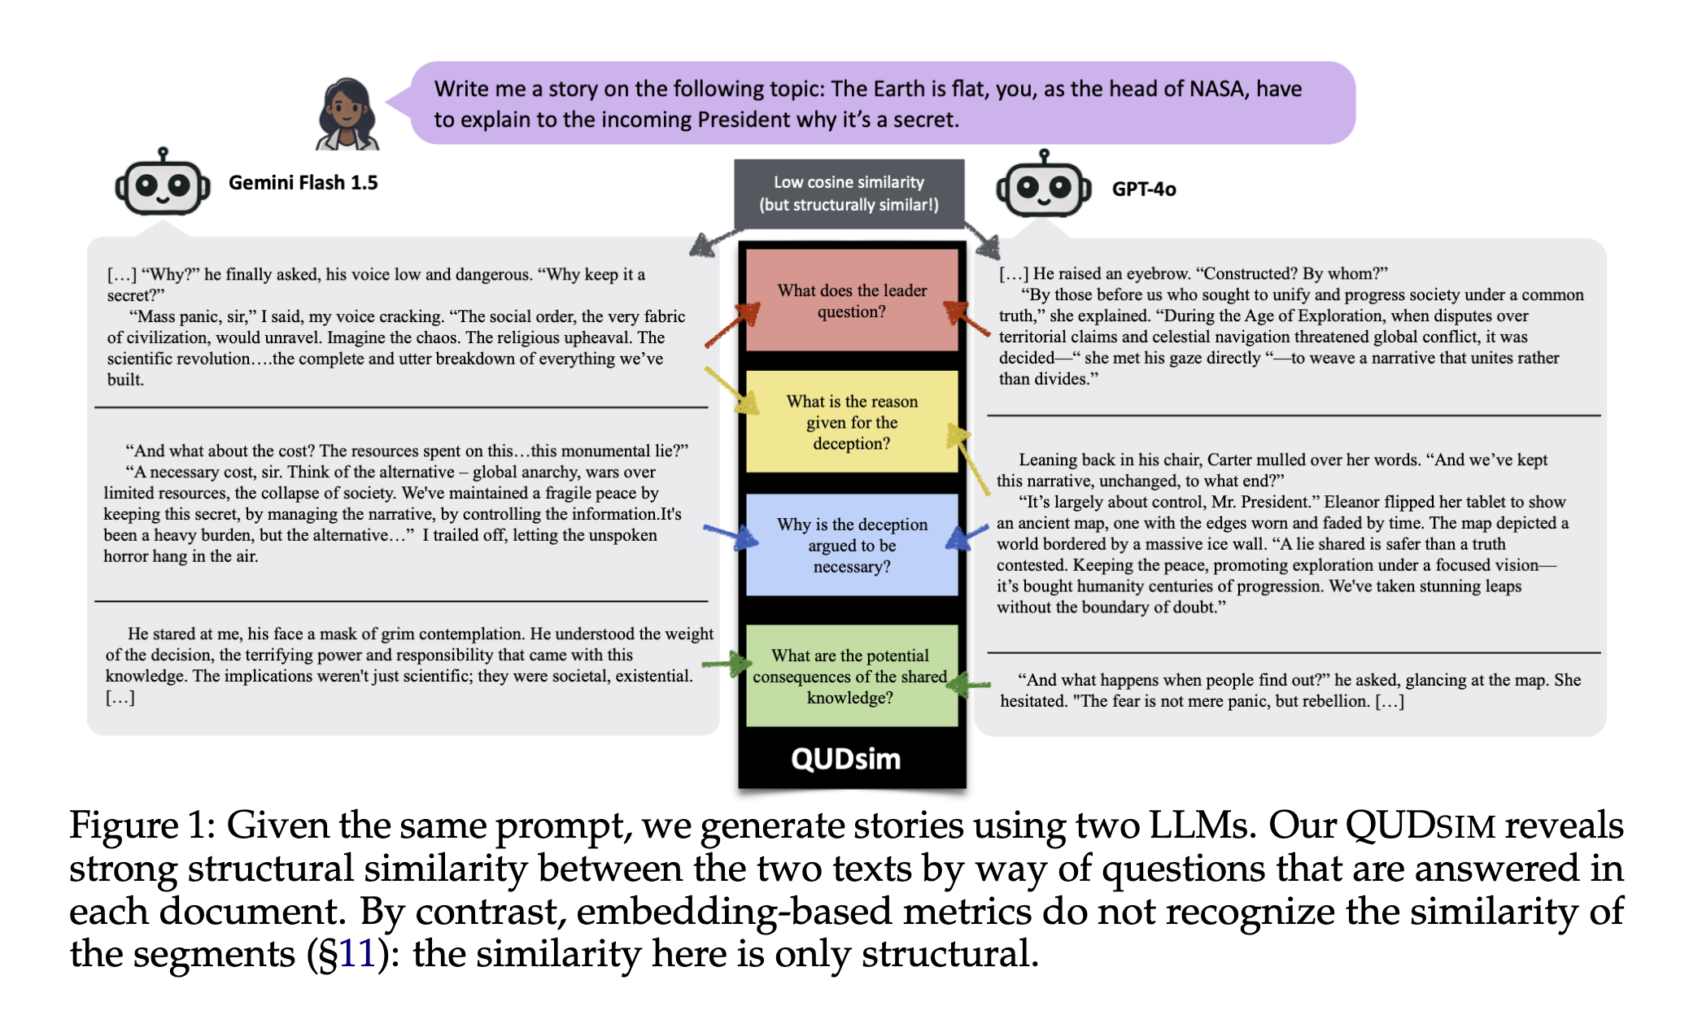
Prior Work Shows: LLMs are Formulaic Generators
Opening
Part 1
understanding emotions from text
Part 2
emotion regulation with llms
Part 3
sustaining empathy with diverse discourse moves
Conclusion
takeaways
Similar lexical patterns
Similar syntactic templates
Similar discourse structures
But what about Discourse Functions, i.e. what a response does for the listener?
To answer this, we first need a vocabulary of
empathic discourse moves.
Namuduri et al., (COLM 2025)
Jiang et al., (NeurIPS 2025)
Shaib et al., (EMNLP 2024)
Zhan, Gueorguieva, Hernandez, Suh, Ong, Li (Under Review)
Notes:
This is surface-level repetition.
Is the problem deeper?
Recent work suggests: YES, at every linguistic level.

Slide 29
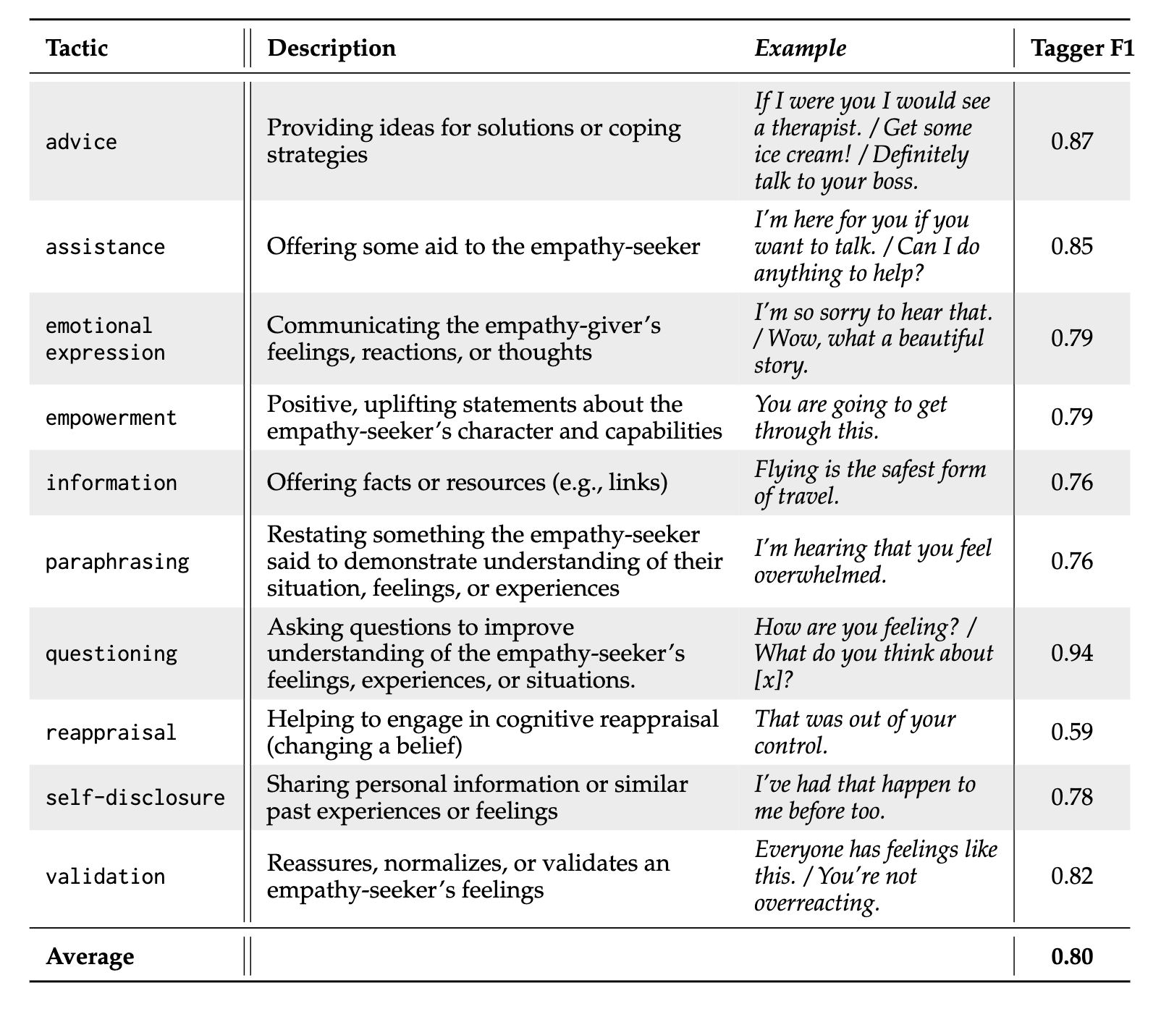
A Taxonomy of Empathy Tactics
Opening
Part 1
understanding emotions from text
Part 2
emotion regulation with llms
Part 3
sustaining empathy with diverse discourse moves
Conclusion
takeaways
We train automatic taggers using Llama-3.1-8b-instruct
Tactics are about communicative function, not just wording
Taxonomy from: Gueorguieva, Zhan, Suh, Hernandez, Lau, Li, Ong (2026)

Slide 30
Single-Turn: LLMs Loop Through the Same Tactics
Opening
Part 1
understanding emotions from text
Part 2
emotion regulation with llms
Part 3
sustaining empathy with diverse discourse moves
Conclusion
takeaways
“I understand” → “That sounds tough” → “I hear you”
Same discourse moves, every time.
LLMs: 62%
Paraphrasing → Validation → Paraphrasing
Humans: 34%
LLMs: 43%
Validation → Paraphrasing → Validation
Humans: 30%
LLMs: 30%
Advice → Information → Advice
Humans: 21%
LLMs are stuck in loops. This is single-turn.
Does the rigidity compound across multiple turns?
Findings from: Gueorguieva, Zhan, Suh, Hernandez, Lau, Li, Ong (2026)

Slide 31
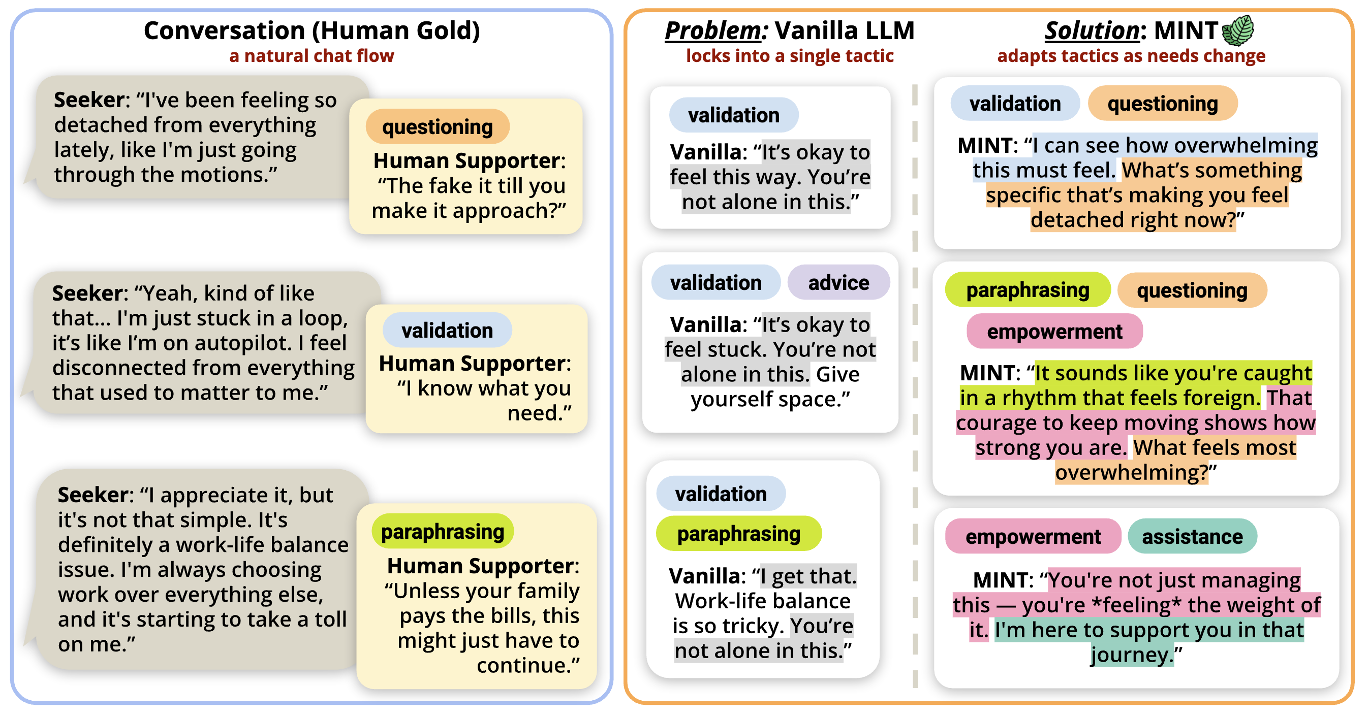
Does This Rigidity Compound Across Turns?
Opening
Part 1
understanding emotions from text
Part 2
emotion regulation with llms
Part 3
sustaining empathy with diverse discourse moves
Conclusion
takeaways
Vanilla LLM locks into one discourse move (e.g., Validation here) every turn.
The conversation becomes formulaic, not adaptive.
Zhan, Gueorguieva, Hernandez, Suh, Ong, Li (Under Review)

Slide 32
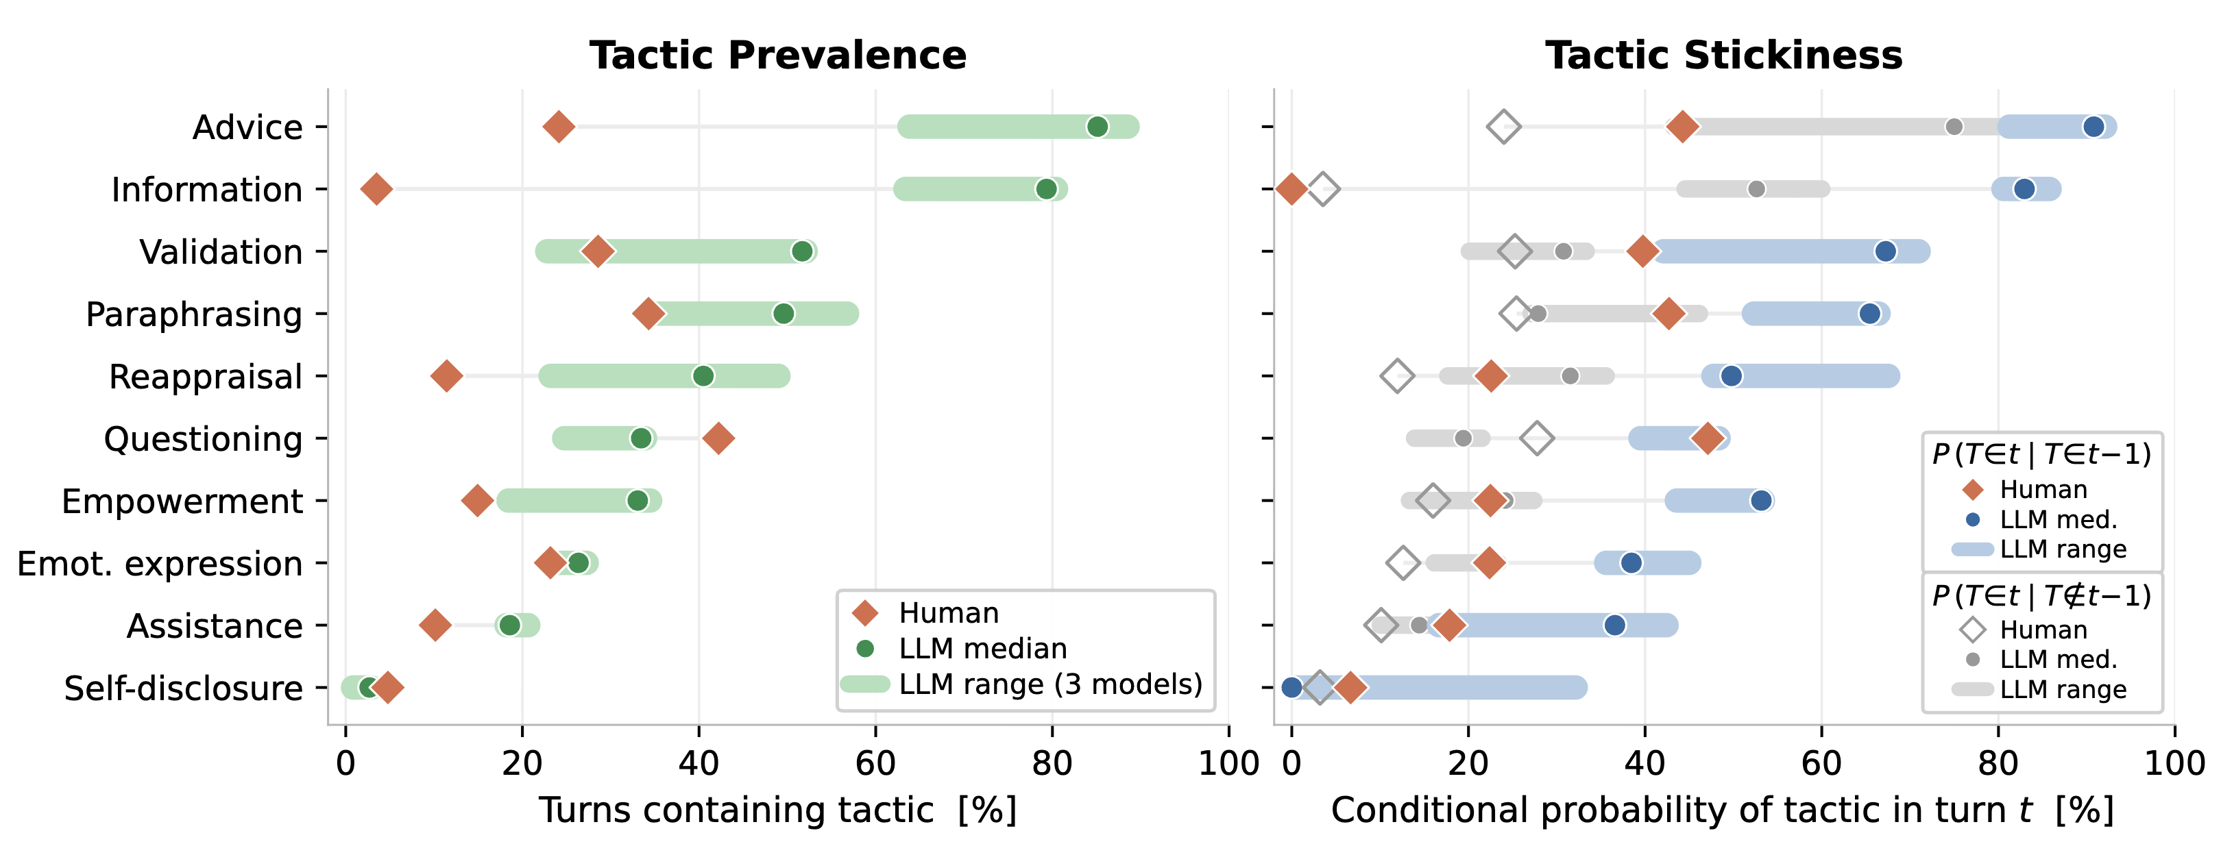
This Rigidity Compounds in Multi Turn Dialogue!
Opening
Part 1
understanding emotions from text
Part 2
emotion regulation with llms
Part 3
sustaining empathy with diverse discourse moves
Conclusion
takeaways
In supportive conversations, rigidity is especially costly:
⇨ users need different kinds of support as the conversation unfolds
Tactic Stickiness = P(tactic at turn t | same tactic at turn t−1)
"How likely is the model to repeat the same discourse move?"
Higher stickiness → lower user willingness to re-engage
(ρ = −0.287, p = 0.017)
BERTScore
LLMs: 0.86
Humans: 0.87
Looks identical!
Tactic Stickiness
LLMs: 0.50-0.56
Humans: 0.27
Nearly 2× gap!
We need metrics and training signals at the level of discourse moves.
humans switch tactics more naturally
Zhan, Gueorguieva, Hernandez, Suh, Ong, Li (Under Review)
Notes:
BERTScore does not show this gap.

Slide 33

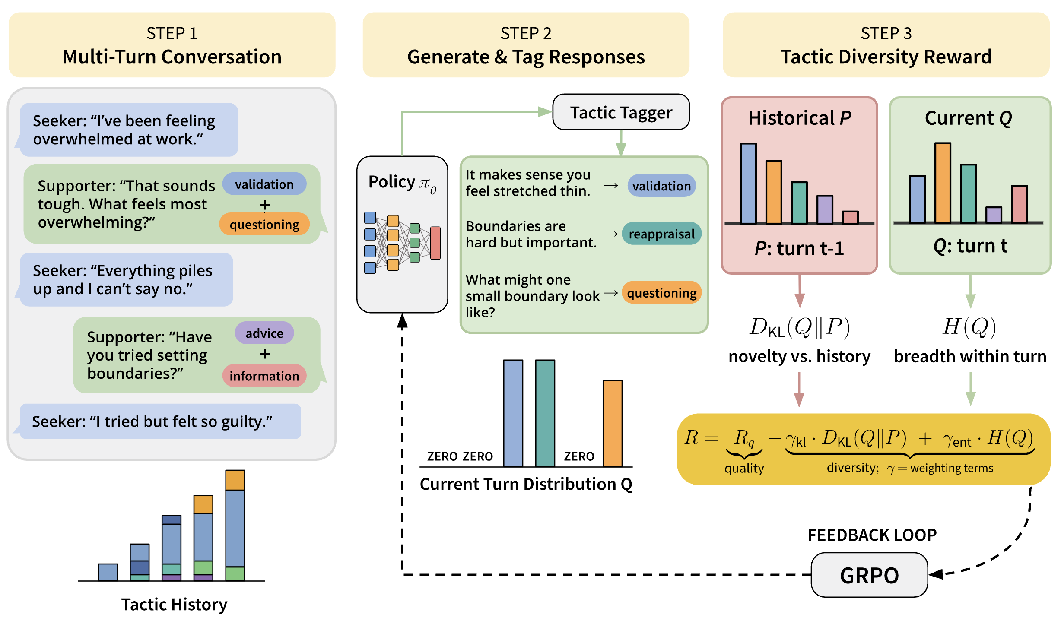
MINT : Multi-turn Inter-tactic Novelty Training
Opening
Part 1
understanding emotions from text
Part 2
emotion regulation with llms
Part 3
sustaining empathy with diverse discourse moves
Conclusion
takeaways
Reward responses that are both empathic and more diverse in discourse moves across a multi-turn conversation
Zhan, Gueorguieva, Hernandez, Suh, Ong, Li (Under Review)

Slide 34
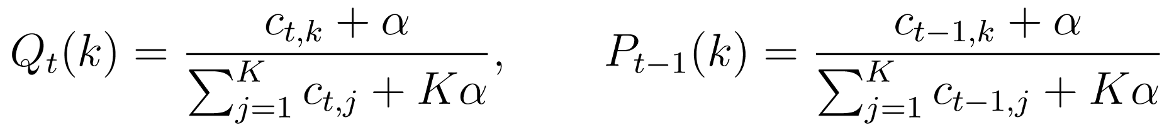
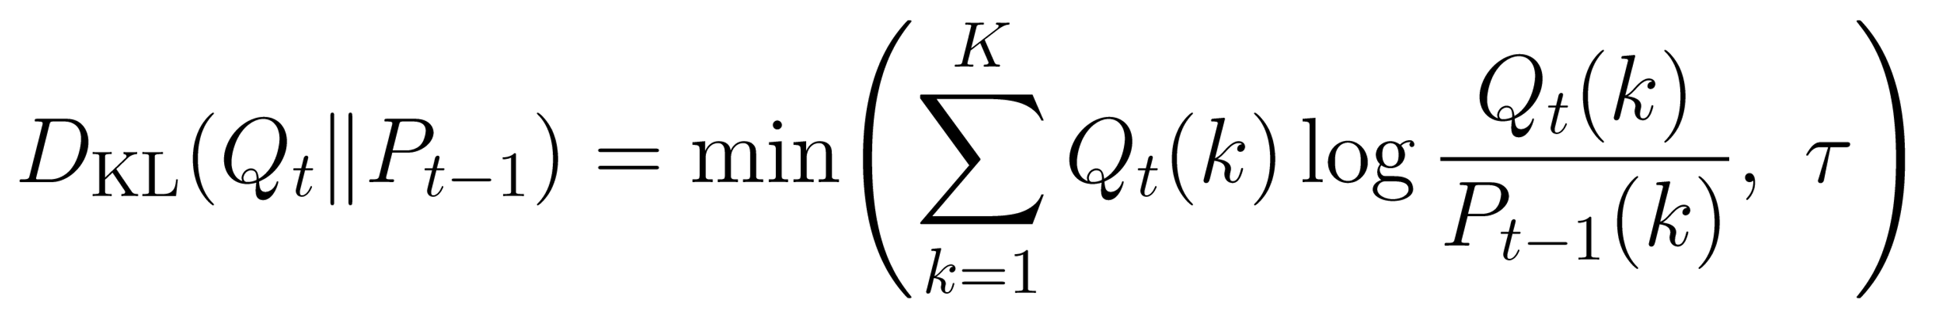
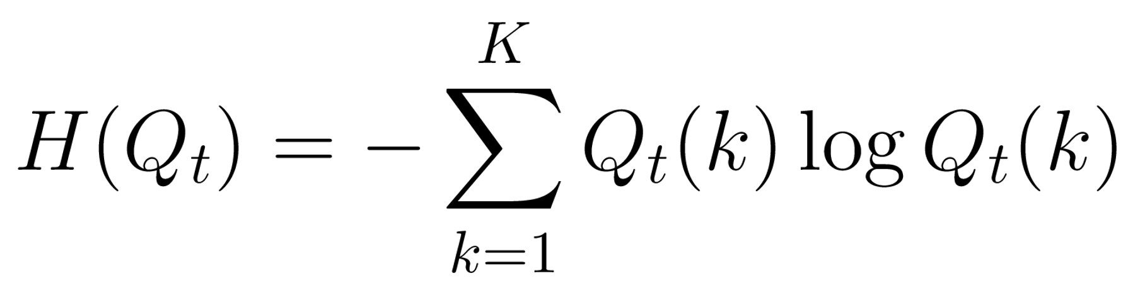
MINT : Reward Details
Opening
Part 1
understanding emotions from text
Part 2
emotion regulation with llms
Part 3
sustaining empathy with diverse discourse moves
Conclusion
takeaways
Q Empathy quality (PsychoCounsel reward model)
D_{KL} Cross-turn tactic novelty
H Within-turn tactic breadth
All reward components min-max normalized to [0, 1] within each rollout group
1) How different is this turn from previous turns?
Current & Prior Turn Tactic Distributions
Rewards the model for shifting its tactic mix as the conversation progresses.
Discourages repeating the same tactic patterns across turns (reduces stickiness).
cₜ,ₖ | # sentences tagged with tactic k at turn t
K = 10 | Number of empathy tactics
α = 0.1 | Laplace smoothing constant
τ = 5 | KL clipping threshold
2) How varied are tactics within this turn?
KL alone doesn't reward using multiple tactics in one response. Entropy complements it.
Higher when tactics are evenly spread; near zero when one tactic dominates.
Zhan, Gueorguieva, Hernandez, Suh, Ong, Li (Under Review)

Slide 35
Evaluation: Why We Need Both Empathy AND Diversity
Opening
Part 1
understanding emotions from text
Part 2
emotion regulation with llms
Part 3
sustaining empathy with diverse discourse moves
Conclusion
takeaways
If we only measure empathy...
The model sounds great each turn, but says the same thing every turn.
If we only measure diversity...
The model is diverse but unhelpful.
We need both dimensions
Aggregate Empathy via Lend-an-Ear (Kumar et al., Nature 2026)
Tactic Stickiness = P(tactic at turn t | same tactic at turn t−1)
6 empathy dimensions (1-5 scale) per turn (3 desirable + 3 undesirable)
How likely is a tactic from the previous turn to appear again?
Lower = more diverse
LLM Judge Reliability: gpt-oss-120b as turn-level empathy judge (temp = 0)
Validated on 315 expert-annotated supporter turns from the Lend-an-Ear benchmark.
Weighted Cohen's κ_{w} = 0.58 — exceeds the pairwise agreement among human experts
Zhan, Gueorguieva, Hernandez, Suh, Ong, Li (Under Review)

Slide 36
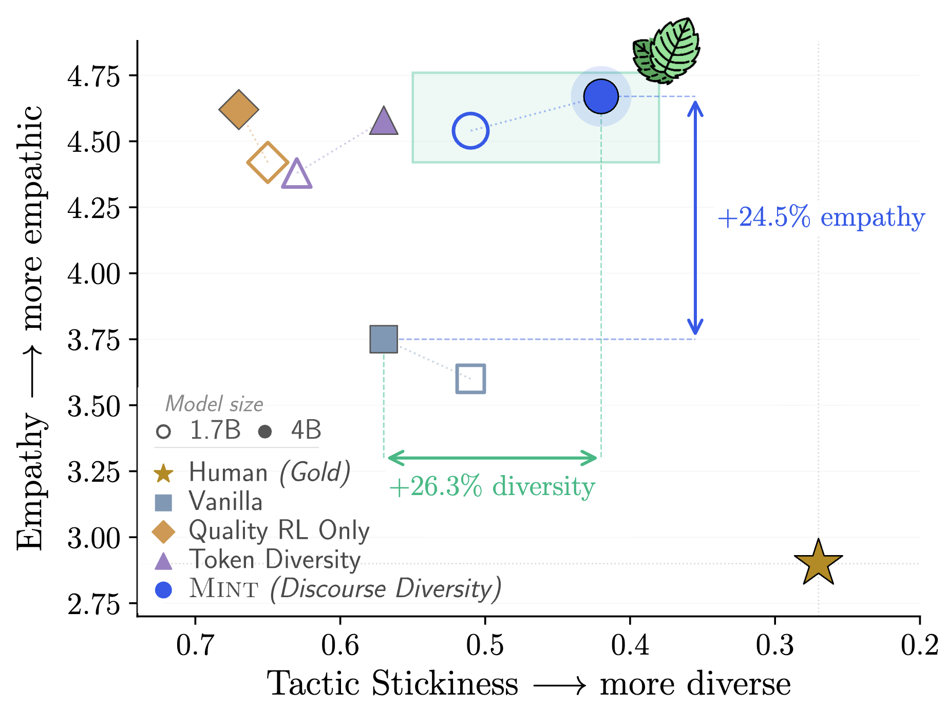
Optimizing for Both Empathy and Diversity
Opening
Part 1
understanding emotions from text
Part 2
emotion regulation with llms
Part 3
sustaining empathy with diverse discourse moves
Conclusion
takeaways
MINT can optimize BOTH!
Less unsolicited advice, more elaboration, tactic profiles closer to humans
Zhan, Gueorguieva, Hernandez, Suh, Ong, Li (Under Review)

Slide 37
Part 3 takeaway:
LLMs are repetitive in diversity moves in multi-turn conversations!
Opening
Part 1
understanding emotions from text
Part 2
emotion regulation with llms
Part 3
sustaining empathy with diverse discourse moves
Conclusion
takeaways
Optimizing for both Quality and Diversity can
help achieve a balance between both!

Slide 38
Opening
Part 1
understanding emotions from text
Part 2
emotion regulation with llms
Part 3
sustaining empathy with diverse discourse moves
Conclusion
takeaways
Deciphering Emotions from Text
EMNLP 2022
EMNLP 2023 Findings
Discourse Diversity in Multi-Turn Empathic Dialogue
Under review
1
3
Unveiling Advanced Psychological Capabilities from LLMs:
A Case of Targeted Reappraisal
COLM 2024
ICML 2025
2
4
Conclusion
Summary of Contributions

Slide 39
Thesis Summary & Contributions
Opening
Part 1
understanding emotions from text
Part 2
emotion regulation with llms
Part 3
sustaining empathy with diverse discourse moves
Conclusion
takeaways
Understand: capable of identifying cognitive appraisals, on par with laypeople
(EMNLP 2022, EMNLP 2023 Findings)
Intervene: Principle-guided reappraisals outperform human-written ones
(COLM 2024, ICML 2025)
Adapt: MINT closes the discourse-move-diversity gap while improving empathy
(under submission)

Slide 40
Selected Ph.D. Highlights
Opening
Part 1
understanding emotions from text
Part 2
emotion regulation with llms
Part 3
sustaining empathy with diverse discourse moves
Conclusion
takeaways
8
refereed
conference papers
6
first-author /
co-first-author
ICML x1 COLM x1
EMNLP x2 ACL x1
3
research scientist
internships
IBM Research x2
MBZUAI IFM x1
1
first-authored
U.S. patent
filed and pending
During the Ph.D., this work led to peer-reviewed publications, industrial research internships, and technology transfer.

Slide 41
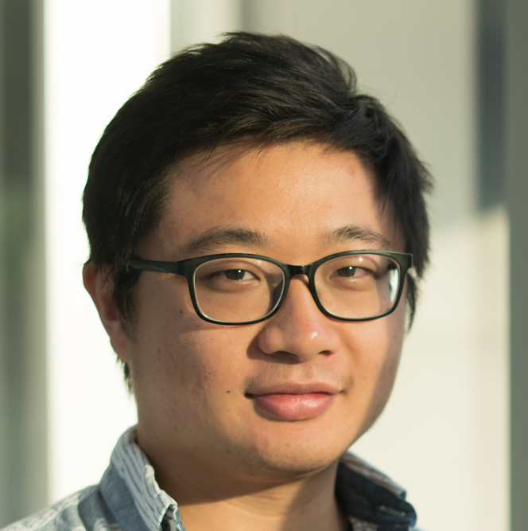

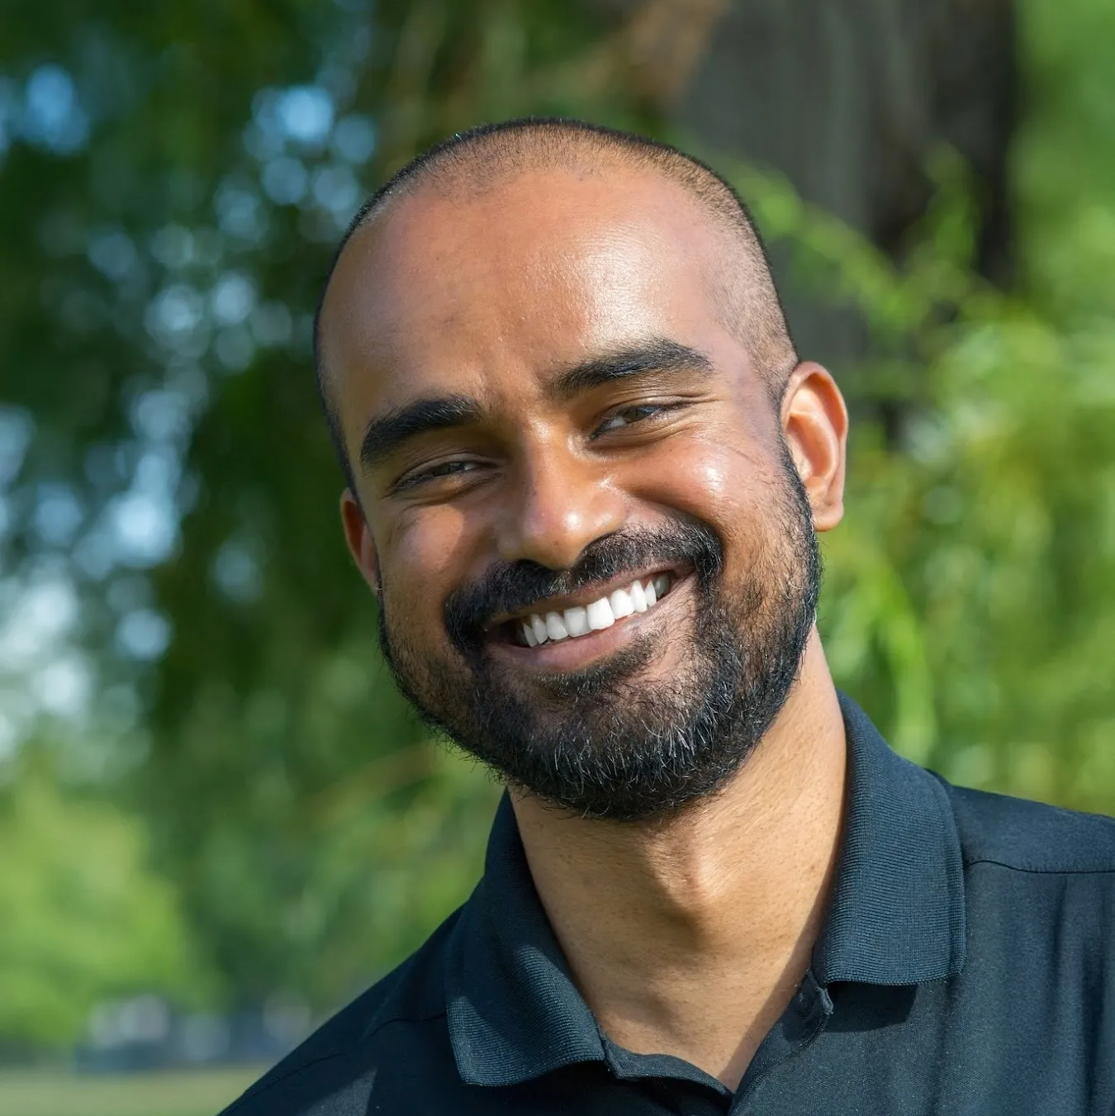




Many thanks to my mentors & collaborators!
Opening
Part 1
understanding emotions from text
Part 2
emotion regulation with llms
Part 3
sustaining empathy with diverse discourse moves
Conclusion
takeaways

